Slide 1

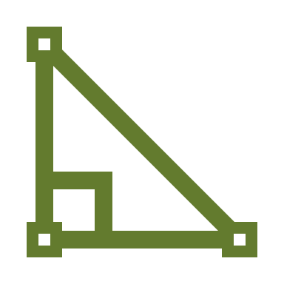
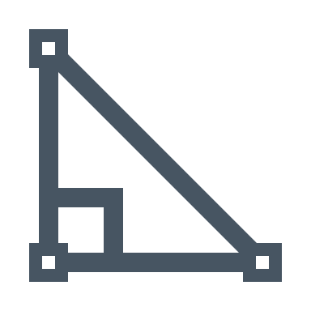

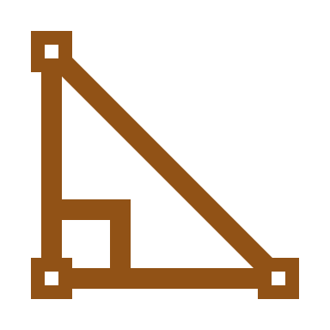
Pivots
The Migration of the Lantis
Paul McKay Easter
Fairbanks, AK
pmeaster@gmail.com
907-328-9949
Archeological Renaissance: Part II

Slide 2
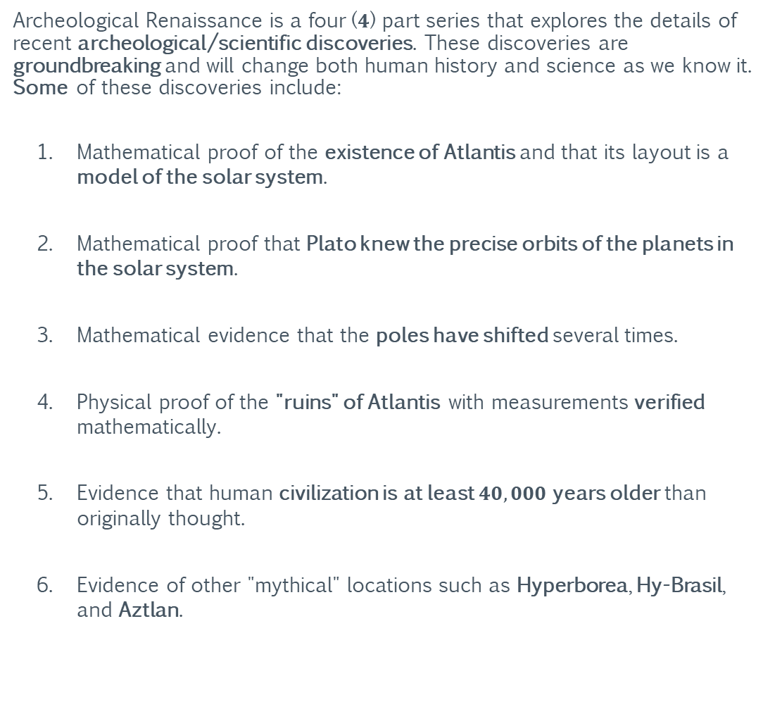
Archeological Renaissance
Summary
Archeological Renaissance is a four ($4$) part series that explores the details of recent archeological/scientific discoveries. These discoveries are groundbreaking and will change both human history and science as we know it. Some of these discoveries include:
Mathematical proof of the existence of Atlantis and that its layout is a model of the solar system.
Mathematical proof that Plato knew the precise orbits of the planets in the solar system.
Mathematical evidence that the poles have shifted several times.
Physical proof of the "ruins" of Atlantis with measurements verified mathematically.
Evidence that human civilization is at least $40,000$years older than originally thought.
Evidence of other "mythical" locations such as Hyperborea, Hy-Brasil, and Aztlan.
Part I: Ants
Part II: Pivots
Part III: Projections
Part IV: Frames

Slide 3
Archeological Renaissance
This Information Shall Remain Free
Grant of Public License
This document is part of a software program. The software program, which includes its documentation, is free: you can redistribute it and/or modify it under the terms of the GNU General Public License as published by the Free Software Foundation, either version 3 of the License, or (at your option) any later version.
This program is distributed in the hope that it will be useful, but without any warranty; without even the implied warranty of merchantability or fitness for a particular purpose. See the GNU General Public License for more details.
You should have received a copy of the GNU General Public License along with this program. If not, see https://www.gnu.org/licenses/.
Part I: Ants
Part II: Pivots
Part III: Projections
Part IV: Frames

Slide 4
Archeological Renaissance
This Information Shall Remain Free
Grant of Current and Future Patents
All rights to any current and future patents, having derived from any quantity of unique and/or proprietary information contained within the software program, generated by the software program, or derived from the use and/or reverse engineering of the software program are reserved.
All reserved rights of said patents are hereby granted to the public.
Image Copyrights
Some images used in this document were acquired through a public image search engine and their use is covered under United States “fair use” laws for academic/non-commercial distribution. However, some images may be subject to additional copyright(s) and/or commercial redistribution restrictions.
Part I: Ants
Part II: Pivots
Part III: Projections
Part IV: Frames
https://www.dmlp.org/legal-guide/fair-use

Slide 5
For Elaina, Collin, and Arianna: This lost world I’ve found; I rebuild for you.
-Dad

Slide 6

Lantis:
noun.
A person who grows and/or cultivates the lavender plant. Originally a French surname based on the occupation of farming lavender.
alt: noun
In Swedish, a term for a person from or living in the countryside.

Slide 7
Section I: True Polar Wander
The following section examines the phenomenon known as True Polar Wander (TPW) and how it relates to the structural alignments of ancient archeological sites.

Slide 8
True Polar Wander
Definition
True polar wander is a solid-body rotation of a planet or moon with respect to its spin axis, causing the geographic locations of the north and south poles to change, or "wander". Unless the body is totally rigid (which the Earth is not) its stable state rotation has the largest moment of inertia axis aligned with the spin axis, with the smaller two moments of inertia axes lying in the plane of the equator. If the body is not in this steady state, true polar wander will occur: the planet or moon will rotate as a rigid body to realign the largest moment of inertia axis with the spin axis.
If the body is near the steady state but with the angular momentum not exactly lined up with the largest moment of inertia axis, the pole position will oscillate. Weather and water movements can also induce small changes.
https://en.wikipedia.org/wiki/True_polar_wander

Slide 9
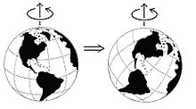
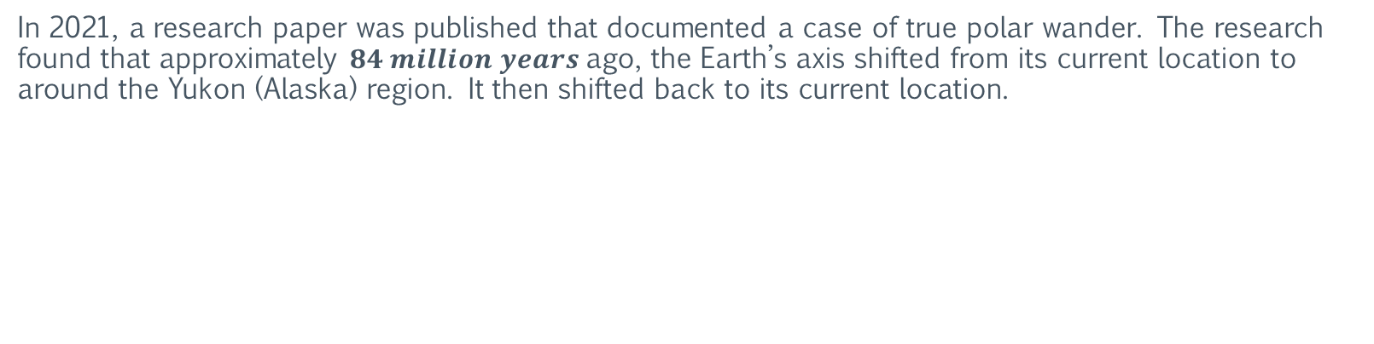
True Polar Wander
Documented Case
In 2021, a research paper was published that documented a case of true polar wander. The research found that approximately $84 million years$ago, the Earth’s axis shifted from its current location to around the Yukon (Alaska) region. It then shifted back to its current location.
https://www.nature.com/articles/s41467-021-23803-8

Slide 10
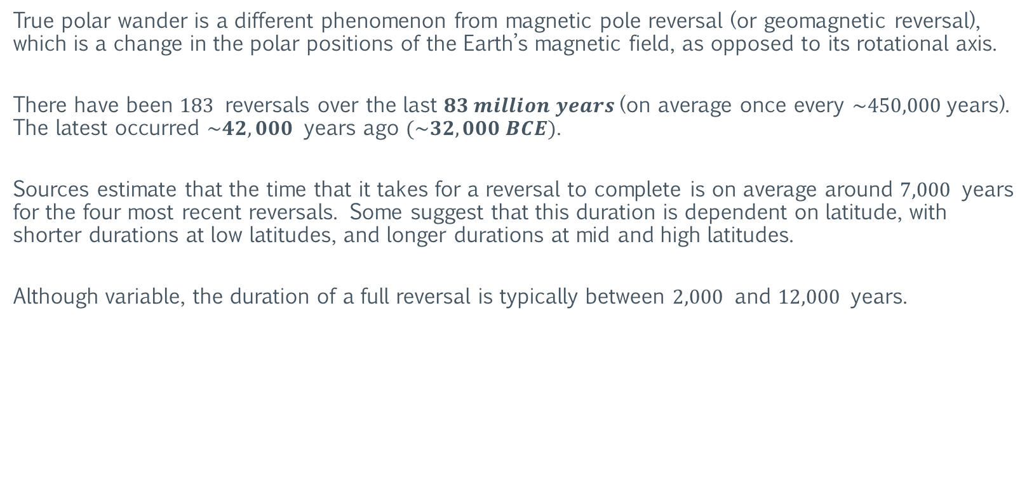
True Polar Wander
Magnetic Pole Reversal
True polar wander is a different phenomenon from magnetic pole reversal (or geomagnetic reversal), which is a change in the polar positions of the Earth’s magnetic field, as opposed to its rotational axis.
There have been $183$ reversals over the last $83 million years$(on average once every $\sim 450,000$years). The latest occurred $\sim 42,000$ years ago $(\sim 32,000 BCE)$.
Sources estimate that the time that it takes for a reversal to complete is on average around $7,000$ years for the four most recent reversals. Some suggest that this duration is dependent on latitude, with shorter durations at low latitudes, and longer durations at mid and high latitudes.
Although variable, the duration of a full reversal is typically between $2,000$ and $12,000$ years.
https://en.wikipedia.org/wiki/Geomagnetic_reversal
https://www.livescience.com/magnetic-flip-42000-years-ago.html

Slide 11
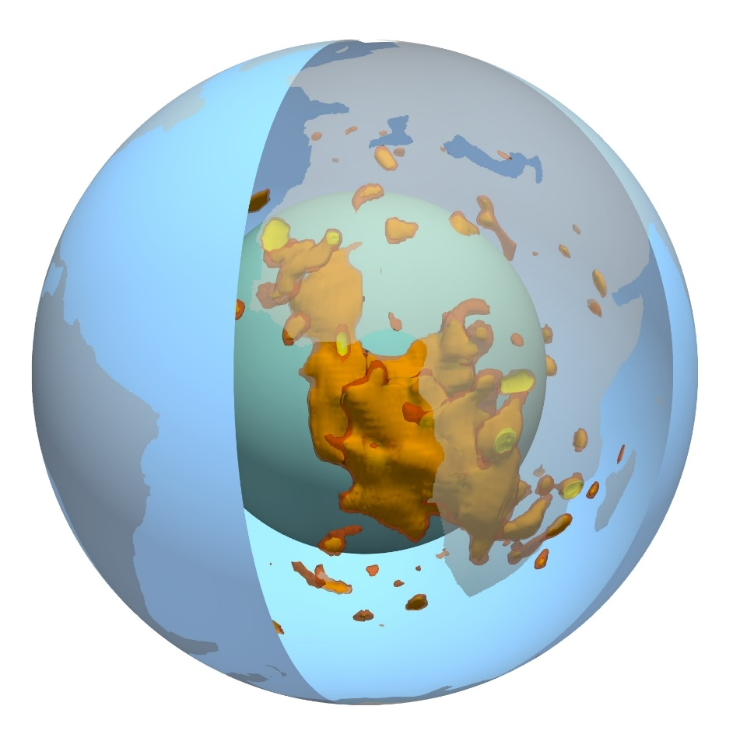
True Polar Wander
The Two Blobs
Deep within Earth's mantle, there are two giant blobs. These blobs consist of mountains of hot, compressed rock.
One sits under Africa (Atlantis), while the other is almost precisely opposite the first, under the Pacific Ocean (Atlantis antipode). But these two blobs are not evenly matched.
New research finds that the blob under Africa extends far closer to the surface — and is more unstable — than the blob under the Pacific. This difference could ultimately help to explain why the crust under Africa has been lifted upward and why the continent has seen so many large super-volcano eruptions over hundreds of millions of years.
The mantle blobs are properly known as "large low-shear-wave-velocity provinces," or LLSVPs.
https://www.livescience.com/mantle-blobs-under-earth

Slide 12
Charles H. Hapgood
Biography and Research
Charles H. Hapgood (May 17, 1904 – December 21, 1982) was an American college professor and author who became one of the best-known advocates of the archaeological claim of a rapid and recent pole shift with catastrophic results. Hapgood received a master's degree from Harvard University in 1929.
While teaching at Springfield College, a student's question about the Lost Continent of Mu prompted a class project to investigate the lost continent of Atlantis, leading Hapgood to investigate possible ways that massive earth changes could occur.
In 1958, Hapgood published The Earth's Shifting Crust. The book included a foreword by Albert Einstein. In Maps of the Ancient Sea Kings (1966) and The Path of the Pole (1970), Hapgood proposed the hypothesis that the Earth's axis has shifted numerous times during geological history.
https://en.wikipedia.org/wiki/Charles_Hapgood

Slide 13
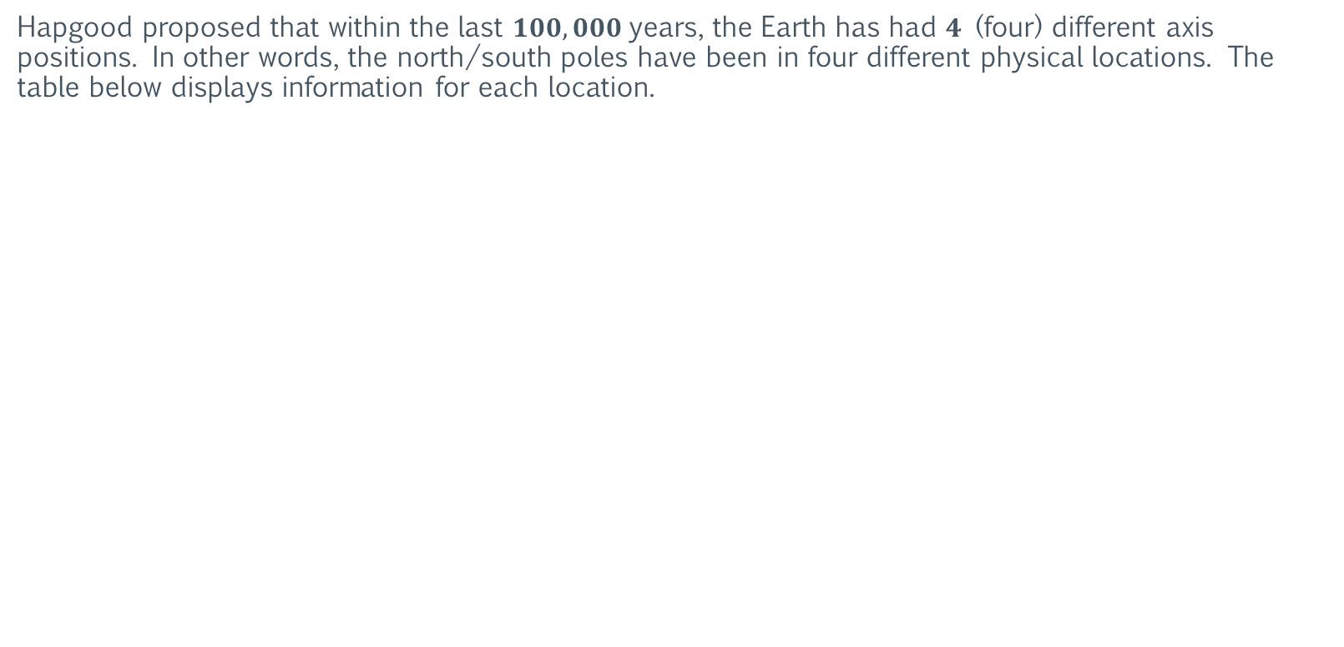
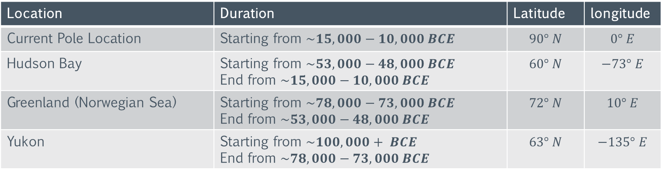
Charles H. Hapgood
Pole Locations
Hapgood proposed that within the last $100,000$years, the Earth has had $4$ (four) different axis positions. In other words, the north/south poles have been in four different physical locations. The table below displays information for each location.
Location | Duration | Latitude | longitude
Current Pole Location | Starting from $\sim 15,000−10,000 BCE$ | $$90° N$$ | $$0° E$$
Hudson Bay | Starting from $\sim 53,000−48,000 BCE$ End from $\sim 15,000−10,000 BCE$ | $$60° N$$ | $$−73° E$$
Greenland (Norwegian Sea) | Starting from $\sim 78,000−73,000 BCE$ End from $\sim 53,000−48,000 BCE$ | $$72° N$$ | $$10° E$$
Yukon | Starting from $\sim 100,000+ BCE$ End from $\sim 78,000−73,000 BCE$ | $$63° N$$ | $$−135° E$$
https://en.wikipedia.org/wiki/Charles_Hapgood

Slide 14
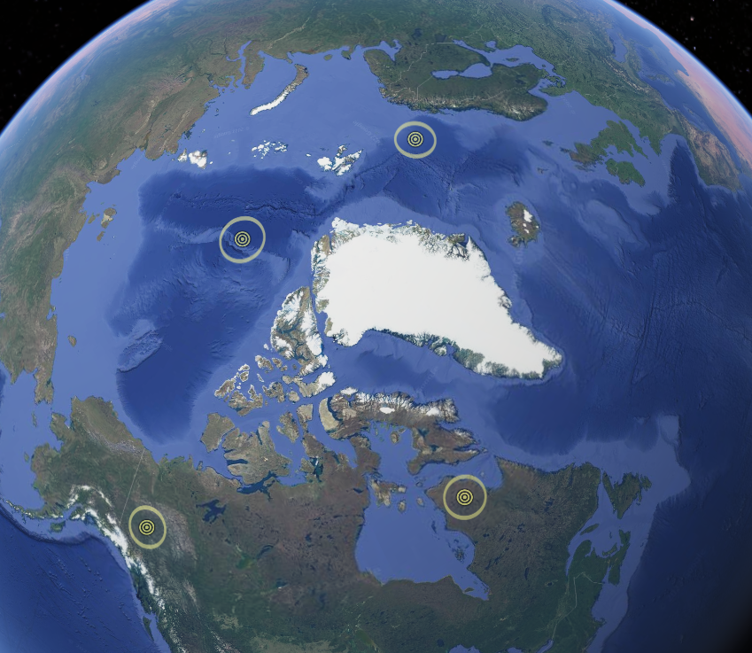
Charles H. Hapgood
Proposed Pole Locations
https://en.wikipedia.org/wiki/Charles_Hapgood

Slide 15
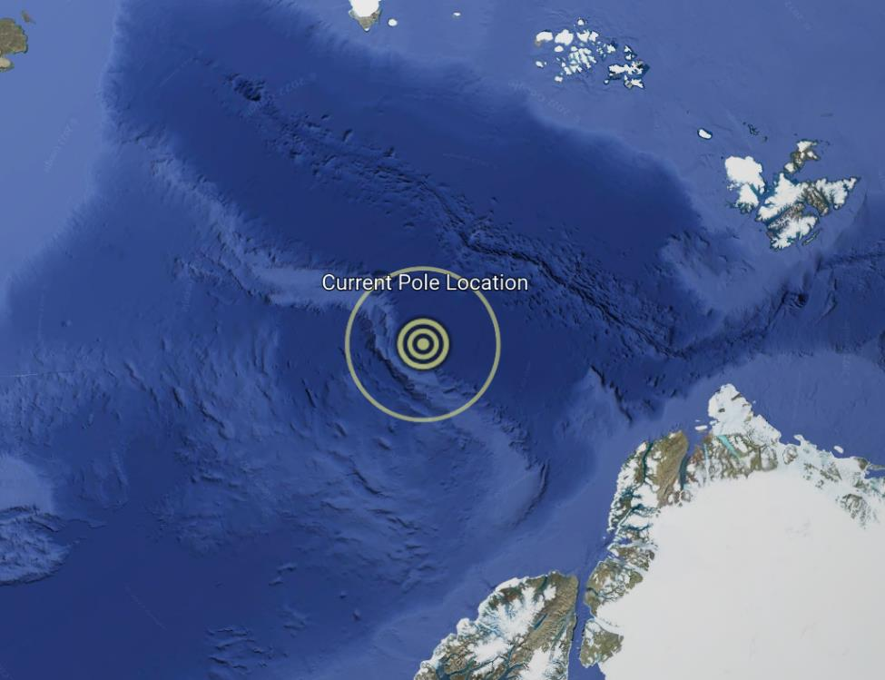
Charles H. Hapgood
Current Pole Location ($90° N, 0° E$)
https://en.wikipedia.org/wiki/Charles_Hapgood

Slide 16
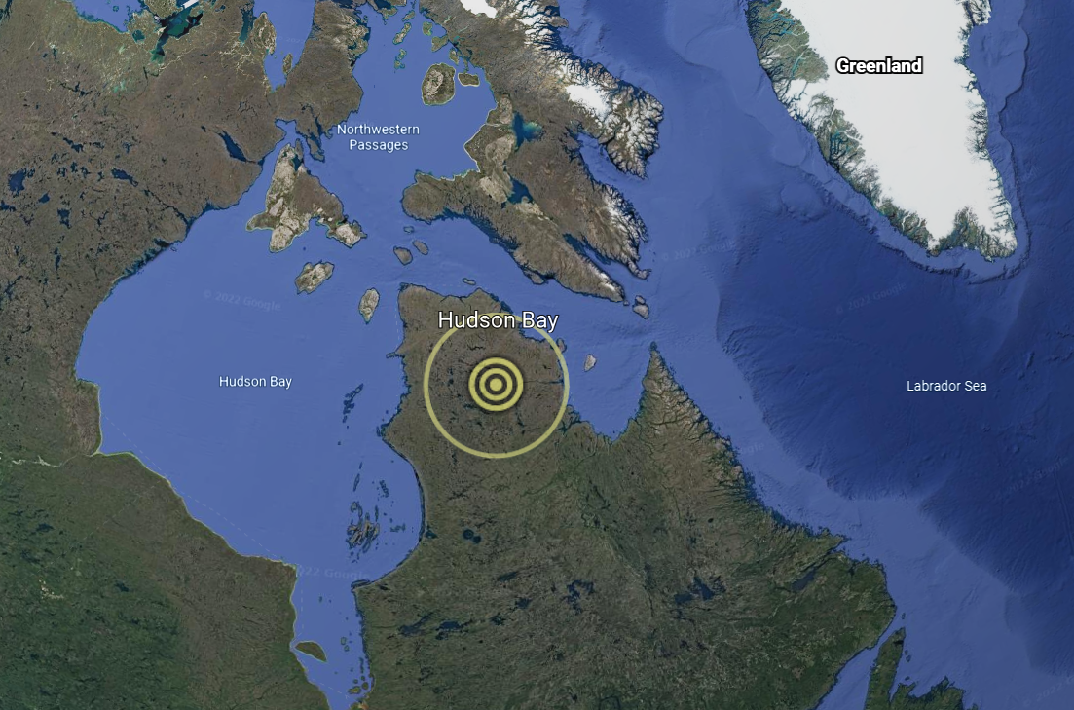
Charles H. Hapgood
Hudson Bay - Proposed Pole Location (6$0° N, −173° E$)
https://en.wikipedia.org/wiki/Charles_Hapgood

Slide 17
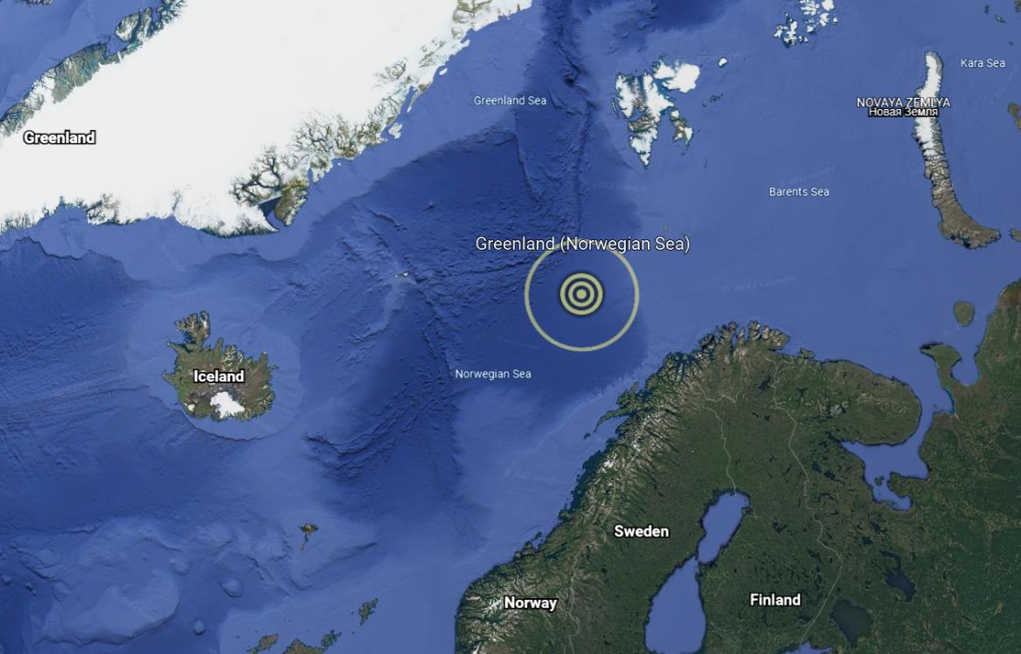
Charles H. Hapgood
Greenland (Norwegian Sea) - Proposed Pole Location (72$° N, 10° E$)
https://en.wikipedia.org/wiki/Charles_Hapgood

Slide 18
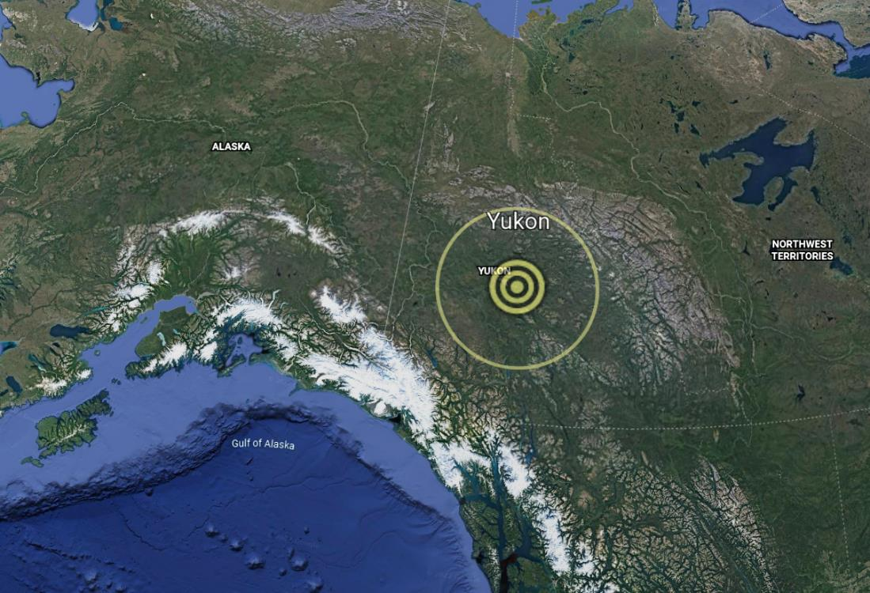
Charles H. Hapgood
Yukon - Proposed Pole Location ($63° N, −135° E$)
https://en.wikipedia.org/wiki/Charles_Hapgood

Slide 19
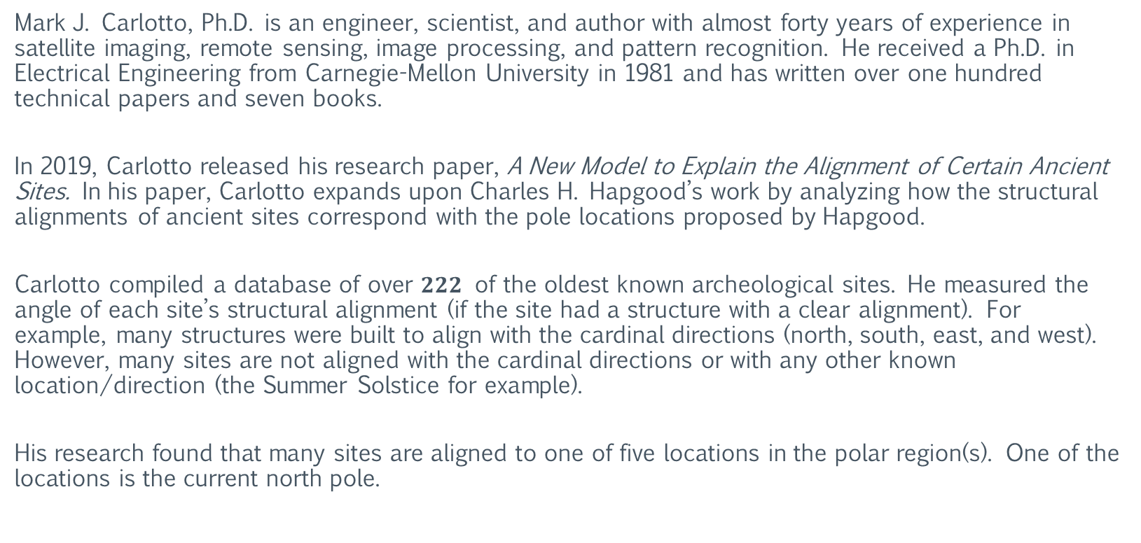
Mark J. Carlotto
Biography and Research
Mark J. Carlotto, Ph.D. is an engineer, scientist, and author with almost forty years of experience in satellite imaging, remote sensing, image processing, and pattern recognition. He received a Ph.D. in Electrical Engineering from Carnegie-Mellon University in 1981 and has written over one hundred technical papers and seven books.
In 2019, Carlotto released his research paper, A New Model to Explain the Alignment of Certain Ancient Sites. In his paper, Carlotto expands upon Charles H. Hapgood’s work by analyzing how the structural alignments of ancient sites correspond with the pole locations proposed by Hapgood.
Carlotto compiled a database of over $222$ of the oldest known archeological sites. He measured the angle of each site’s structural alignment (if the site had a structure with a clear alignment). For example, many structures were built to align with the cardinal directions (north, south, east, and west). However, many sites are not aligned with the cardinal directions or with any other known location/direction (the Summer Solstice for example).
His research found that many sites are aligned to one of five locations in the polar region(s). One of the locations is the current north pole.

Slide 20
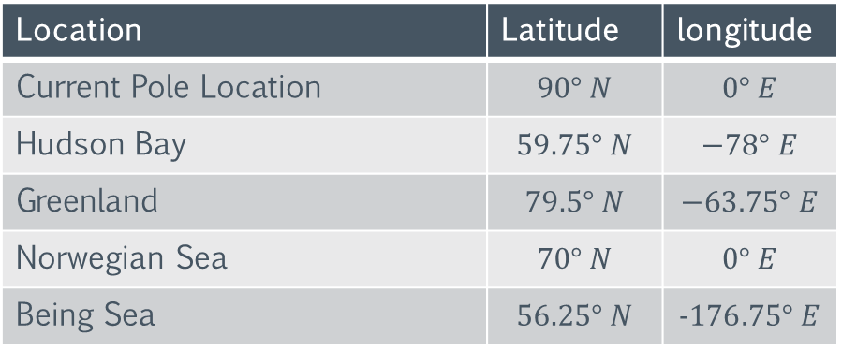
Mark J. Carlotto
Ancient Site Alignment Locations
The table below displays information on all five locations.
Location | Latitude | longitude
Current Pole Location | $$90° N$$ | $$0° E$$
Hudson Bay | $$59.75° N$$ | $$−78° E$$
Greenland | $$79.5° N$$ | $$−63.75° E$$
Norwegian Sea | $$70° N$$ | $$0° E$$
Being Sea | $$56.25° N$$ | $$−176.75° E$$

Slide 21
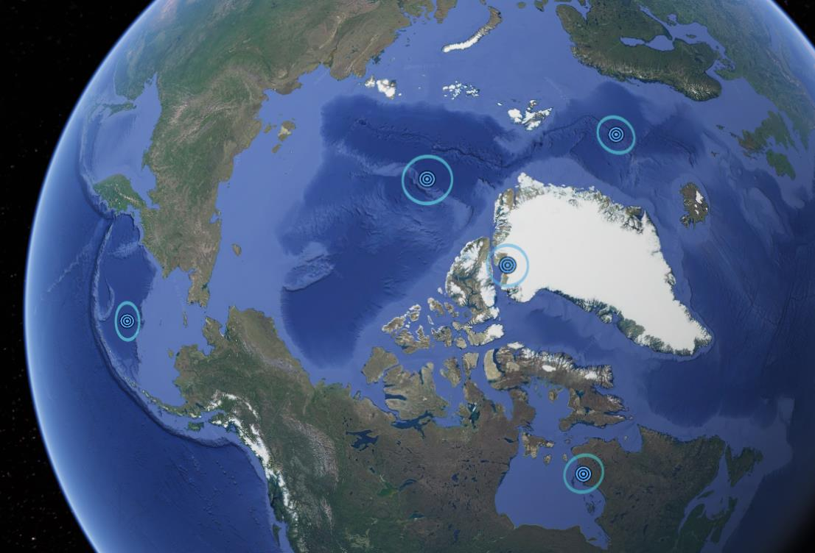
Mark J. Carlotto
Ancient Site Alignment Locations

Slide 22
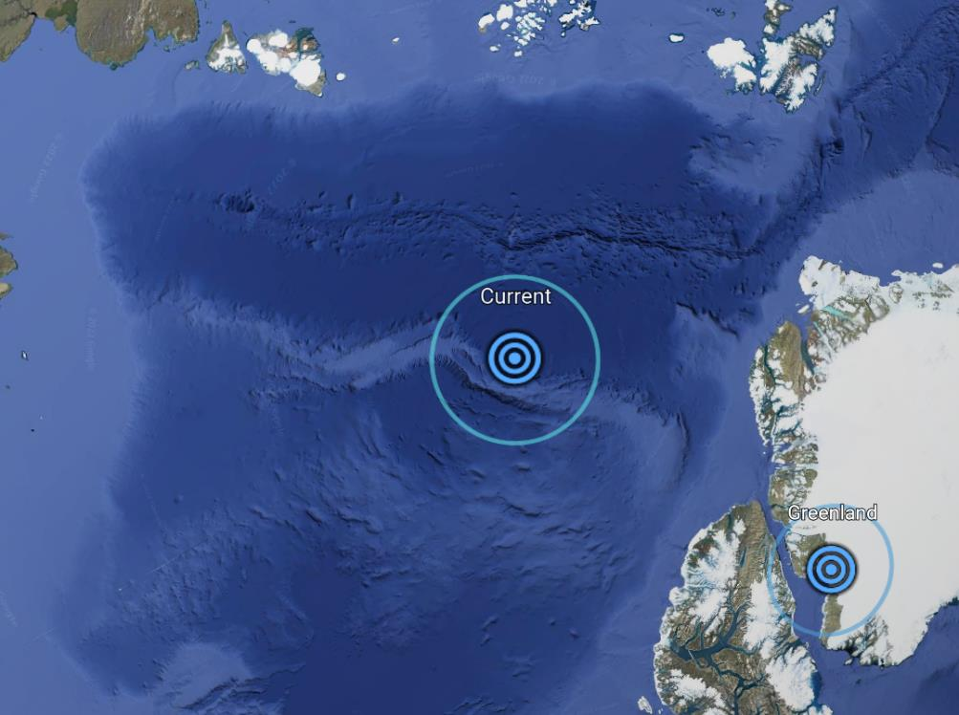
Mark J. Carlotto
Current North Pole – Site Alignment Location

Slide 23
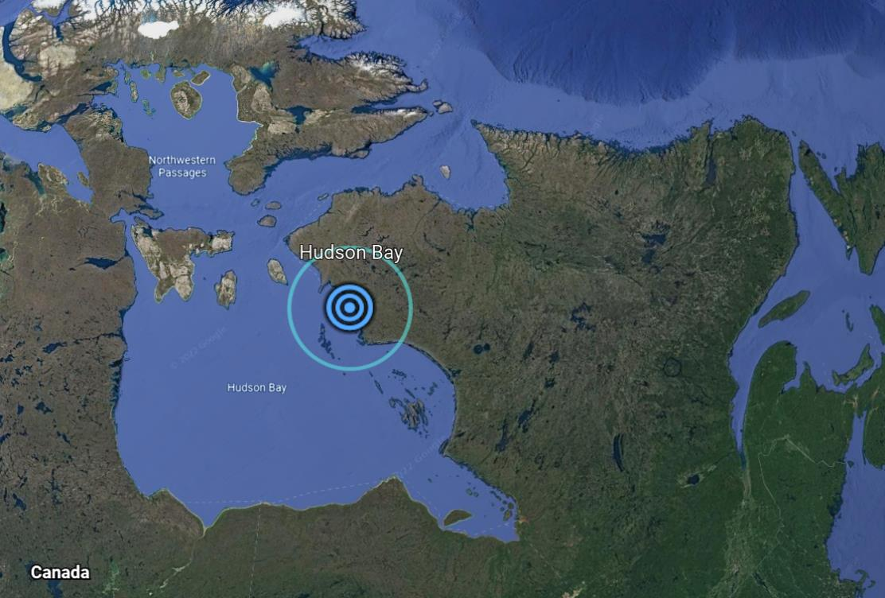
Mark J. Carlotto
Hudson Bay – Site Alignment Location

Slide 24
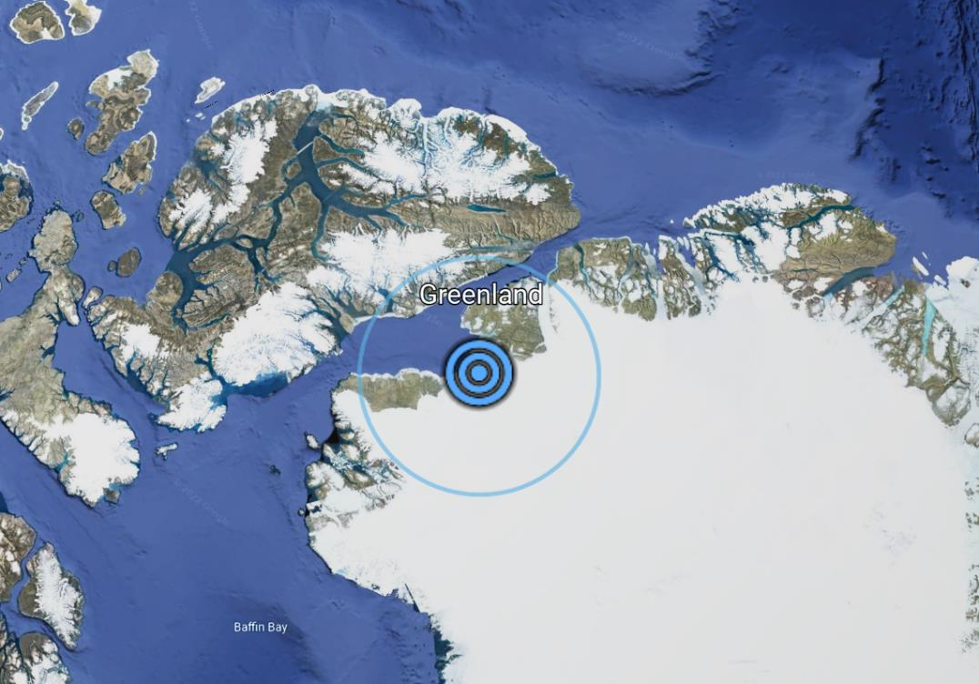
Mark J. Carlotto
Greenland – Site Alignment Location

Slide 25
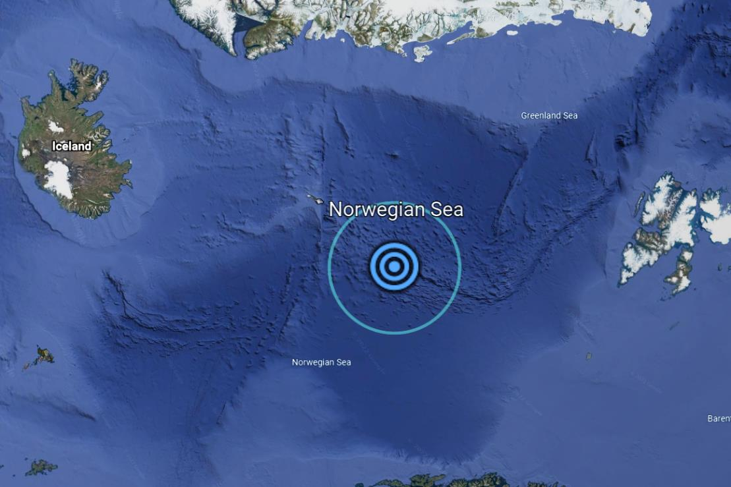
Mark J. Carlotto
Norwegian Sea – Site Alignment Location

Slide 26
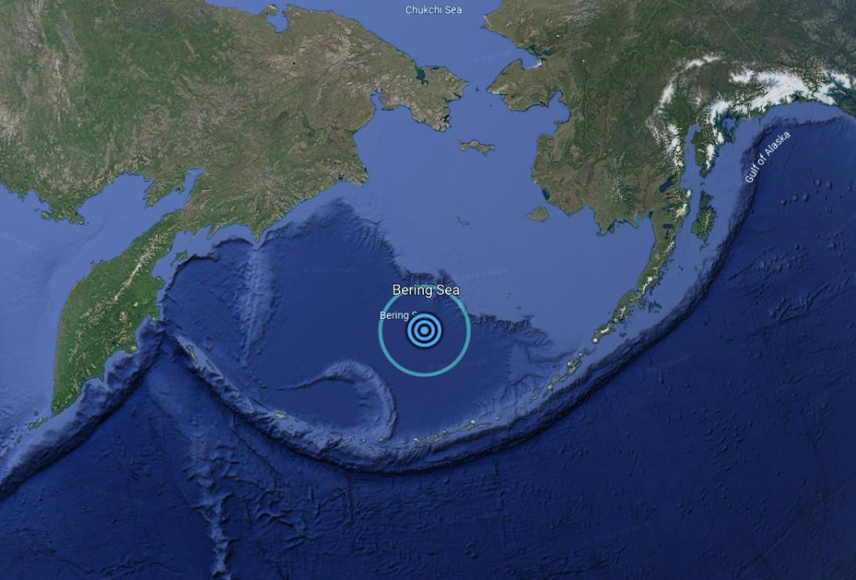
Mark J. Carlotto
Bering Sea – Site Alignment Location

Slide 27
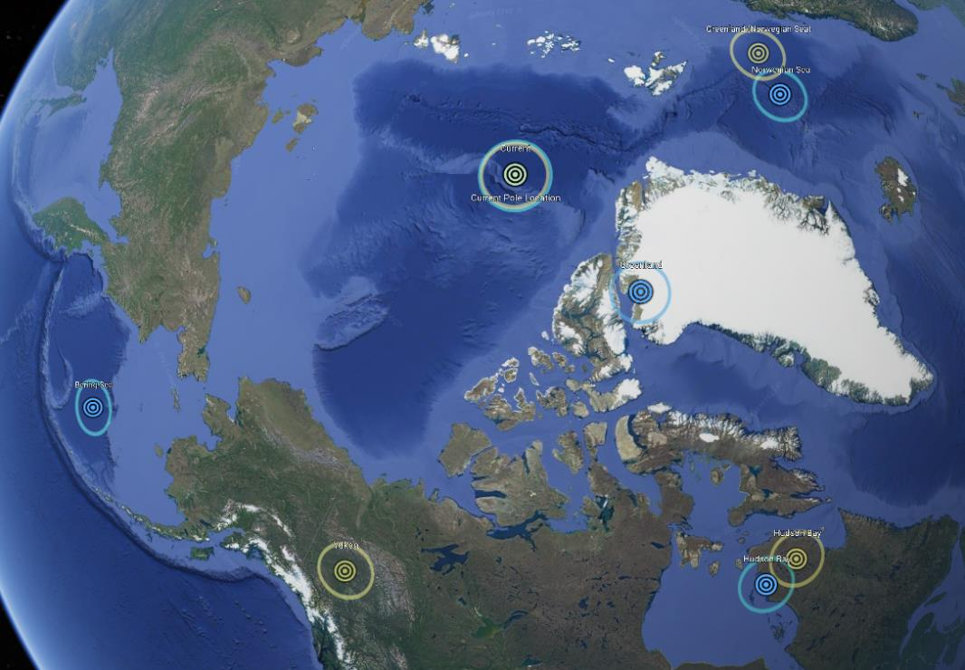
Charles H. Hapgood & Mark J. Carlotto
Pole and Site Alignment Locations

Slide 28
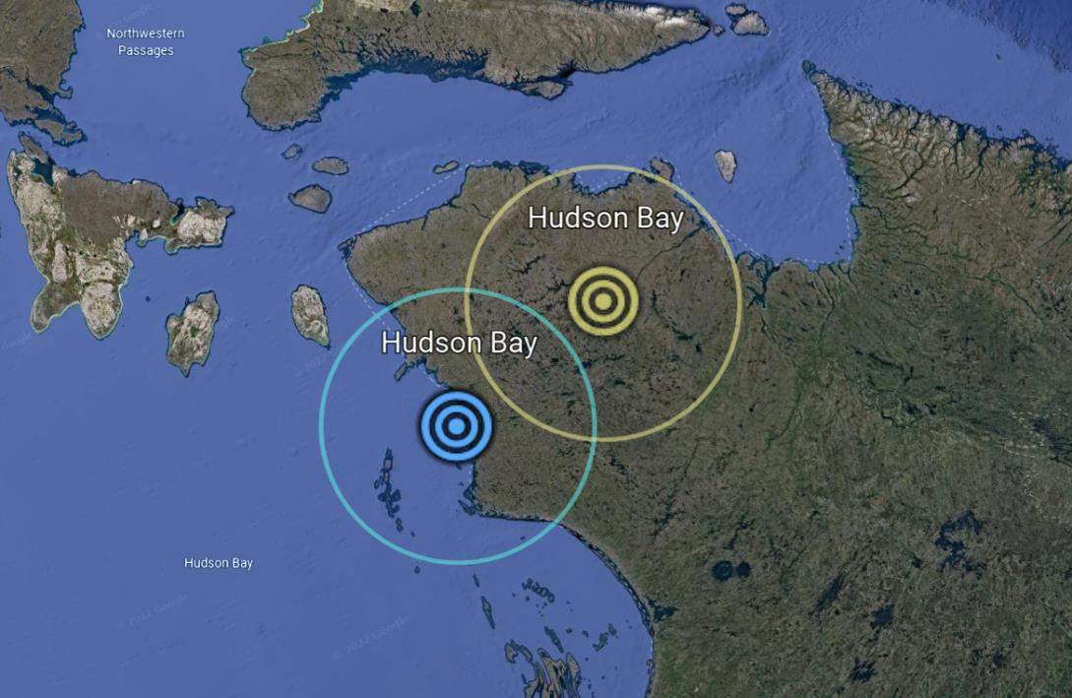
Charles H. Hapgood & Mark J. Carlotto
Hudson Bay – Pole and Site Alignment Location

Slide 29
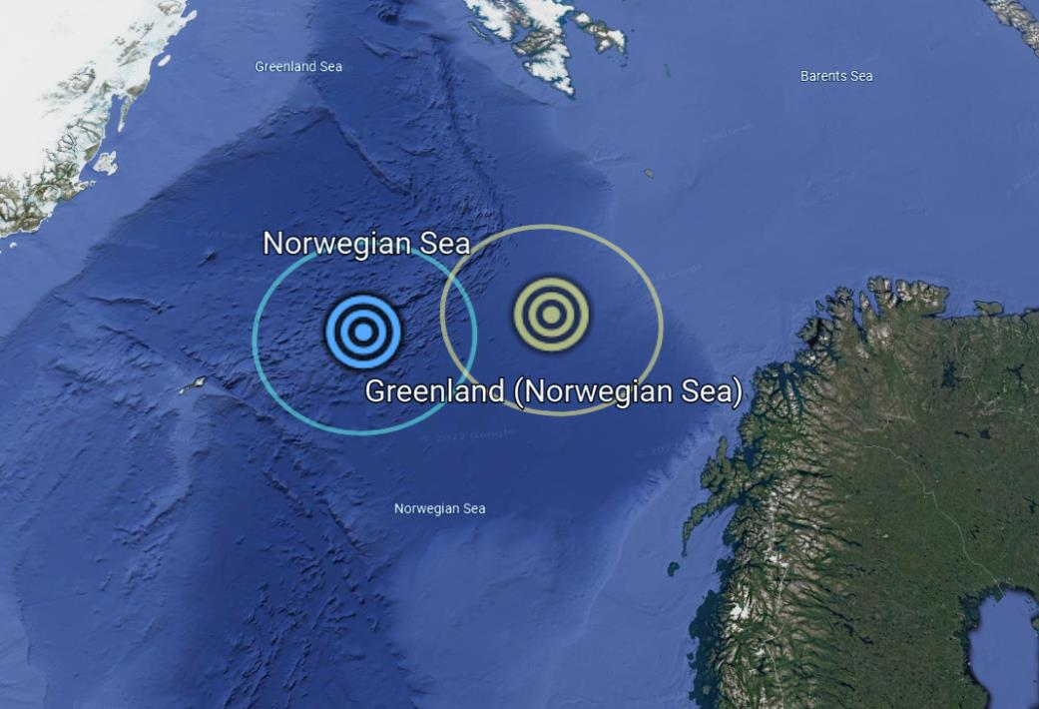
Charles H. Hapgood & Mark J. Carlotto
Norwegian Sea – Pole and Site Alignment Location

Slide 30
Section II: The Probability Matrix
The following section analyzes the research data of Charles H. Hapgood and Mark J. Carlotto. Precise targets of the structural alignments of ancient archeological sites are determined using a “probability matrix” created from millions of calculations. These angle/azimuth values used in the calculations are taken directly from the research of Mark J. Carlotto.

Slide 31
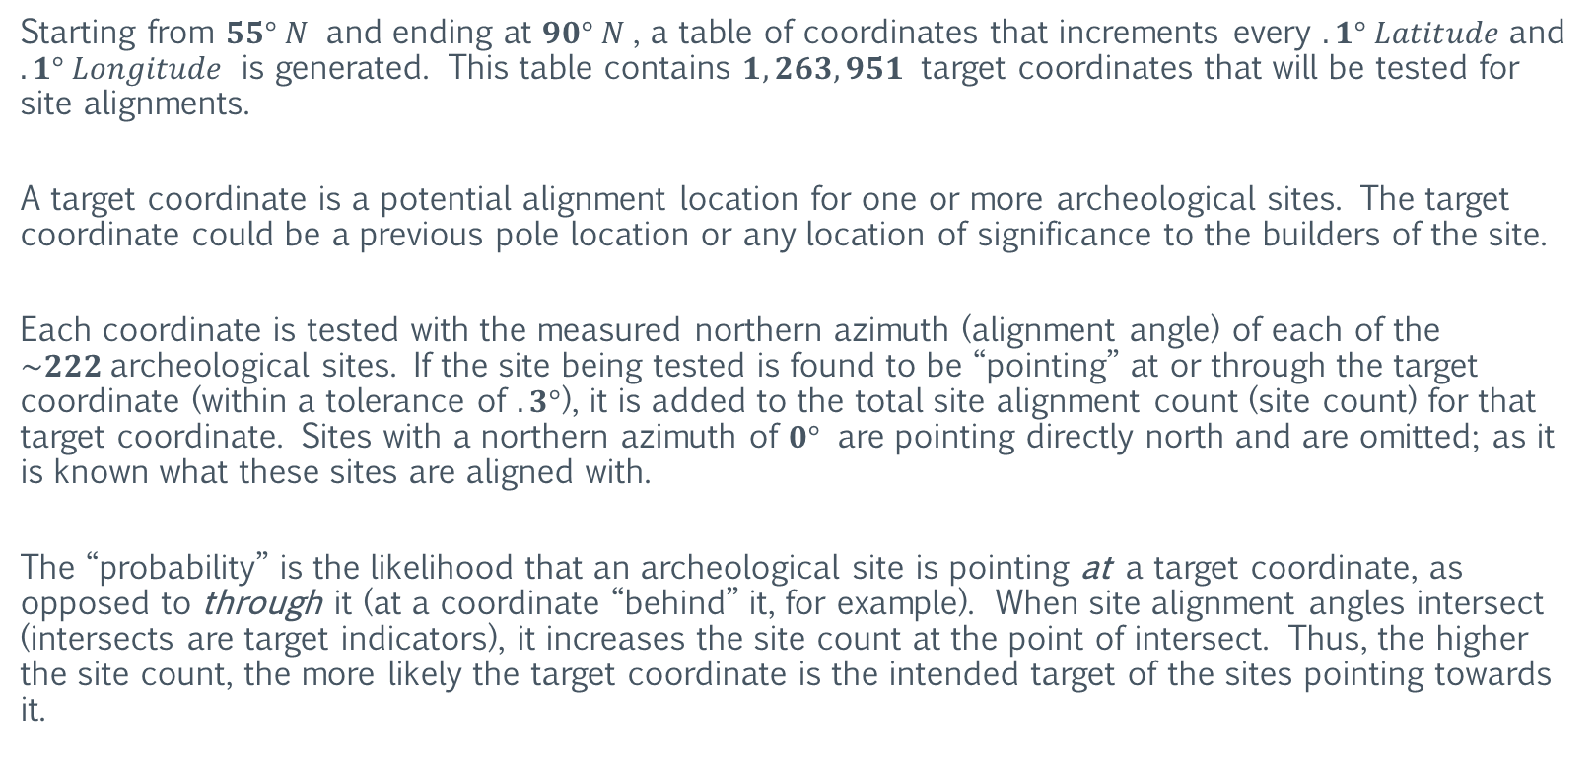
The Probability Matrix
Northern Azimuth Calculation
Starting from $55° N$ and ending at $90° N$, a table of coordinates that increments every $.1° Latitude$and $.1° Longitude$ is generated. This table contains $1,263,951$ target coordinates that will be tested for site alignments.
A target coordinate is a potential alignment location for one or more archeological sites. The target coordinate could be a previous pole location or any location of significance to the builders of the site.
Each coordinate is tested with the measured northern azimuth (alignment angle) of each of the $\sim 222$archeological sites. If the site being tested is found to be “pointing” at or through the target coordinate (within a tolerance of $.3°$), it is added to the total site alignment count (site count) for that target coordinate. Sites with a northern azimuth of $0°$ are pointing directly north and are omitted; as it is known what these sites are aligned with.
The “probability” is the likelihood that an archeological site is pointing at a target coordinate, as opposed to through it (at a coordinate “behind” it, for example). When site alignment angles intersect (intersects are target indicators), it increases the site count at the point of intersect. Thus, the higher the site count, the more likely the target coordinate is the intended target of the sites pointing towards it.

Slide 32
The Probability Matrix
Northern Azimuth Calculation Results
Using $280,597,122$ test calculations, the probability matrix is generated (each test calculation performs $2−3$ separate trigonometry calculations). The matrix is truncated below its peaks to remove angle intersect “noise”. The top $5$ ($five$) zones are listed below.
Bering Sea
Beaufort Sea
Greenland
Hudson Bay
Norwegian Sea

Slide 33
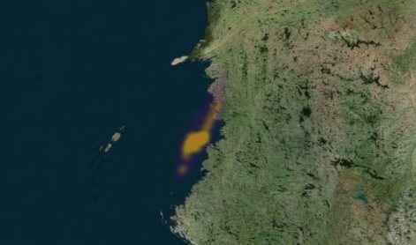
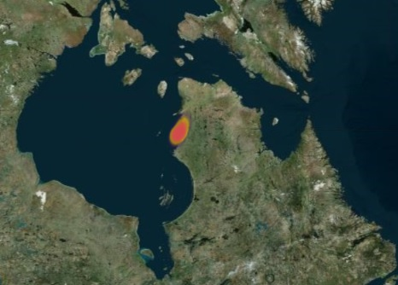
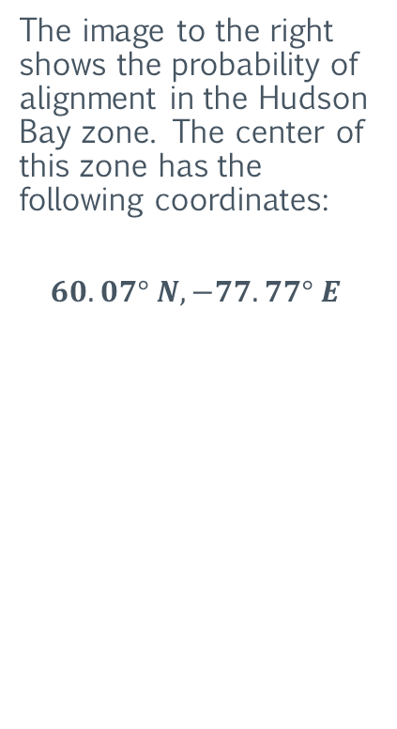
The Probability Matrix
Northern Azimuth Calculation Results: Hudson Bay Zone
The image to the right shows the probability of alignment in the Hudson Bay zone. The center of this zone has the following coordinates:
$$60.07° N, −77.77° E$$
Note that the images are a two-dimensional map projection and are for visual reference only. So, the topography image below the zones may not reflect their precise location on the Earth.

Slide 34
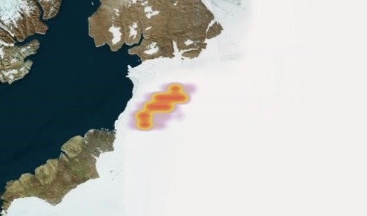
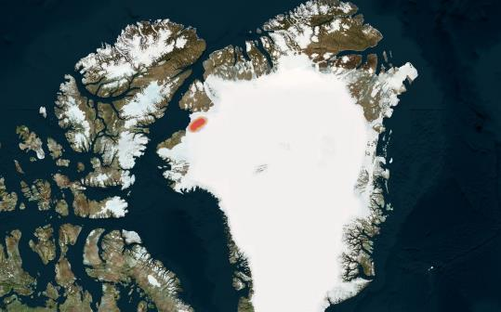
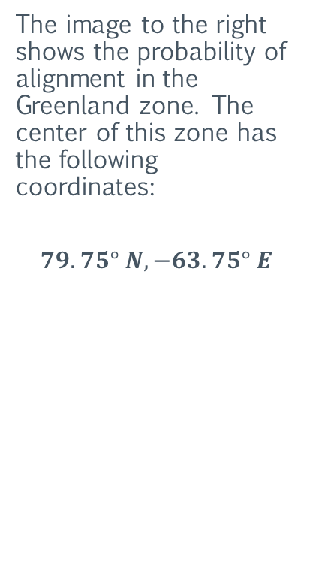
The Probability Matrix
Northern Azimuth Calculation Results: Greenland Zone
The image to the right shows the probability of alignment in the Greenland zone. The center of this zone has the following coordinates:
$$79.75° N, −63.75° E$$
Note that the images are a two-dimensional map projection and are for visual reference only. So, the topography image below the zones may not reflect their precise location on the Earth.

Slide 35
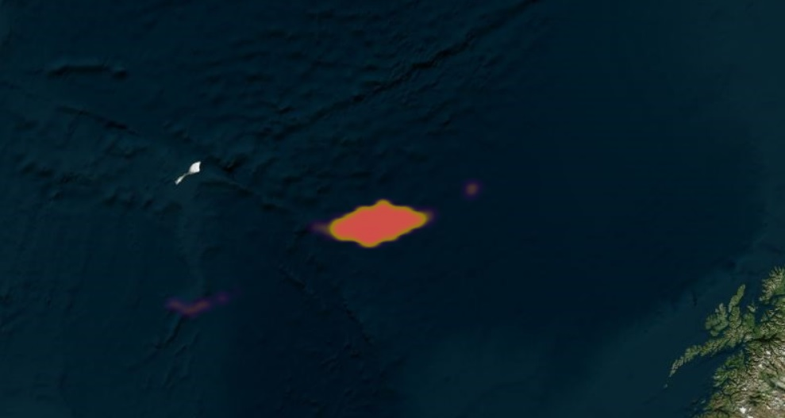
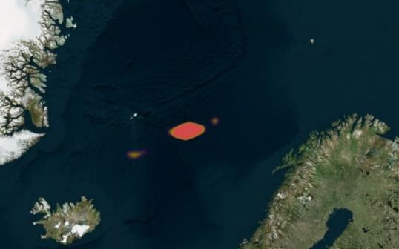
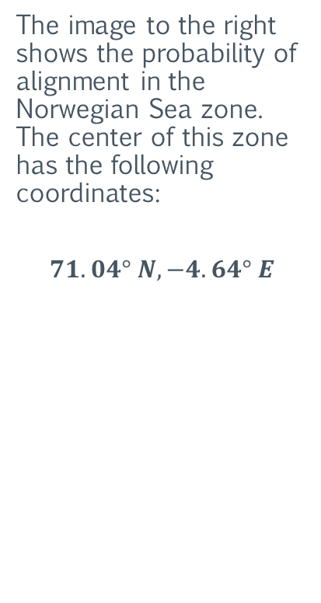
The Probability Matrix
Northern Azimuth Calculation Results: Norwegian Sea Zone
The image to the right shows the probability of alignment in the Norwegian Sea zone. The center of this zone has the following coordinates:
$$71.04° N, −4.64° E$$
Note that the images are a two-dimensional map projection and are for visual reference only. So, the topography image below the zones may not reflect their precise location on the Earth.

Slide 36
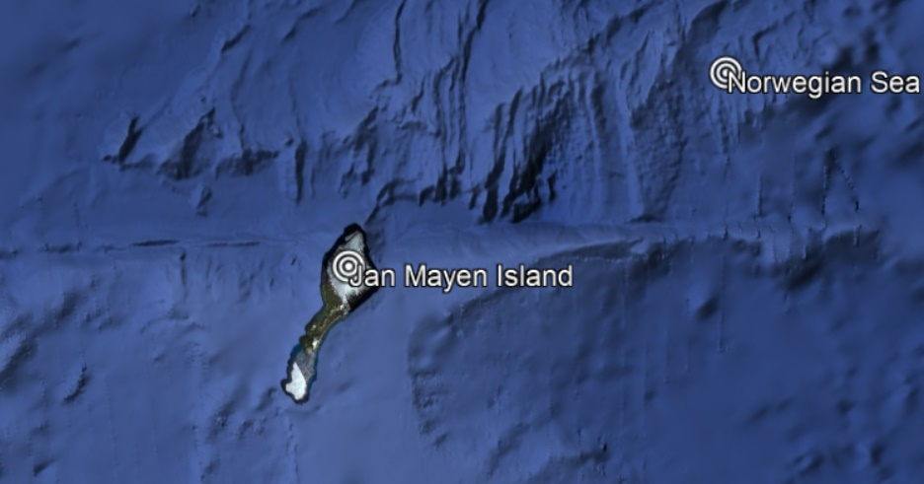
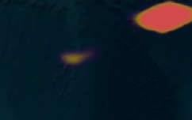
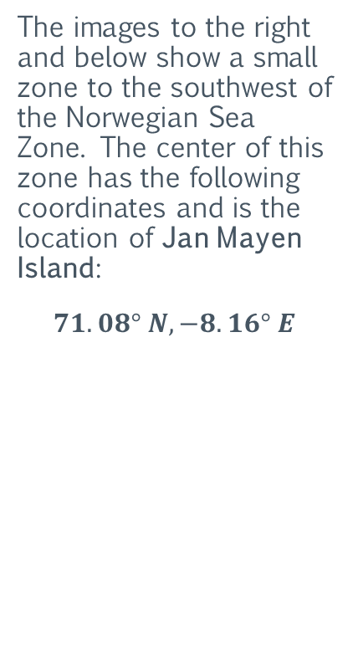
The Probability Matrix
Northern Azimuth Calculation Results: Norwegian Sea Zone
The images to the right and below show a small zone to the southwest of the Norwegian Sea Zone. The center of this zone has the following coordinates and is the location of Jan Mayen Island:
$$71.08° N, −8.16° E$$
Note that the images are a two-dimensional map projection and are for visual reference only. So, the topography image below the zones may not reflect their precise location on the Earth.

Slide 37
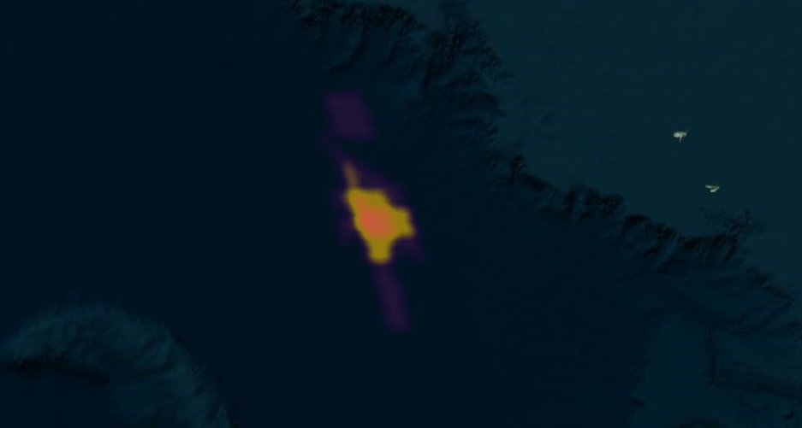
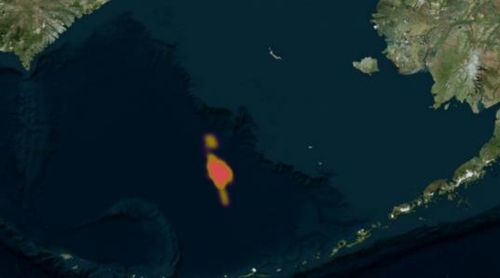
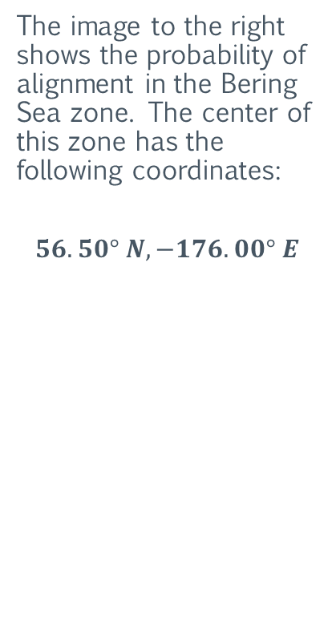
The Probability Matrix
Northern Azimuth Calculation Results: Bering Sea Zone
The image to the right shows the probability of alignment in the Bering Sea zone. The center of this zone has the following coordinates:
$$56.50° N, −176.00° E$$
Note that the images are a two-dimensional map projection and are for visual reference only. So, the topography image below the zones may not reflect their precise location on the Earth.

Slide 38
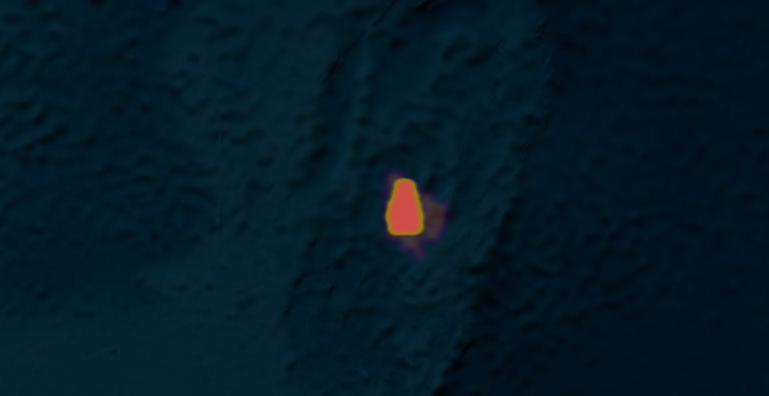
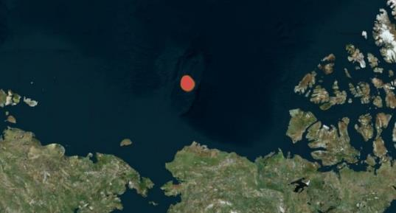
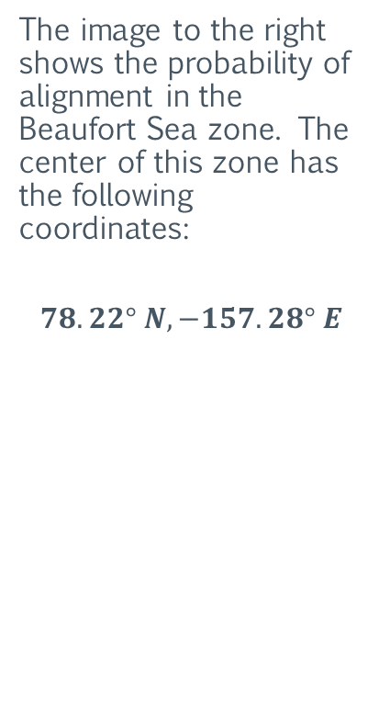
The Probability Matrix
Northern Azimuth Calculation Results: Beaufort Sea Zone
The image to the right shows the probability of alignment in the Beaufort Sea zone. The center of this zone has the following coordinates:
$$78.22° N, −157.28° E$$
Note that the images are a two-dimensional map projection and are for visual reference only. So, the topography image below the zones may not reflect their precise location on the Earth.

Slide 39
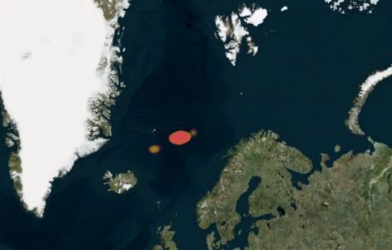
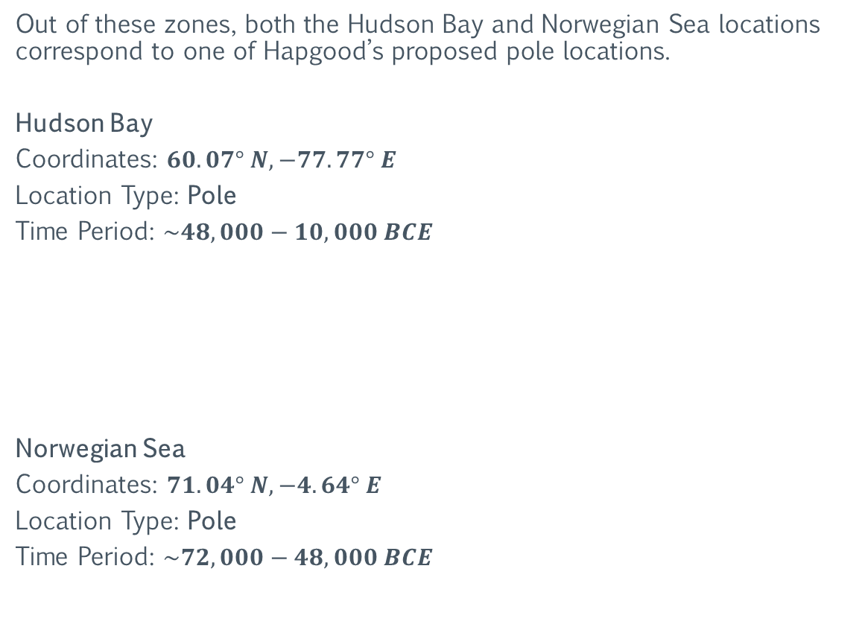
The Probability Matrix
Northern Azimuth Calculation Results: Pole Locations
Out of these zones, both the Hudson Bay and Norwegian Sea locations correspond to one of Hapgood’s proposed pole locations.
Hudson Bay
Coordinates: $60.07° N, −77.77° E$
Location Type: Pole
Time Period: $\sim 48,000−10,000 BCE$
Norwegian Sea
Coordinates: $71.04° N, −4.64° E$
Location Type: Pole
Time Period: $\sim 72,000−48,000 BCE$

Slide 40
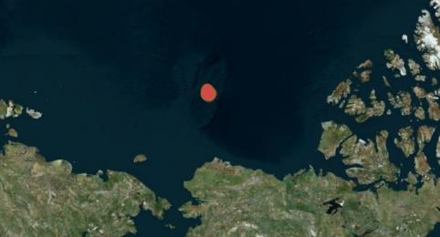

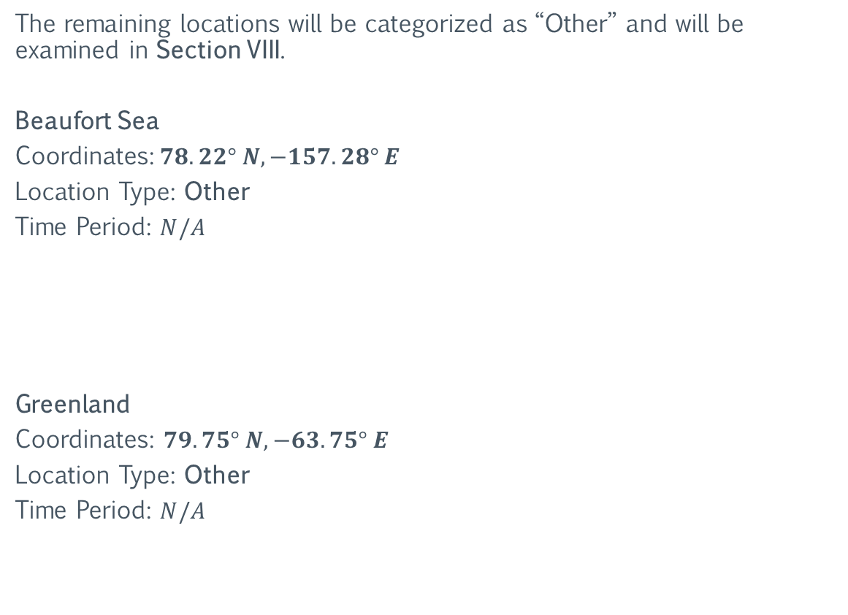
The Probability Matrix
Northern Azimuth Calculation Results: “Other” Locations
The remaining locations will be categorized as “Other” and will be examined in Section VIII.
Beaufort Sea
Coordinates:$78.22° N, −157.28° E$
Location Type: Other
Time Period: $N/A$
Greenland
Coordinates: $79.75° N, −63.75° E$
Location Type: Other
Time Period: $N/A$

Slide 41
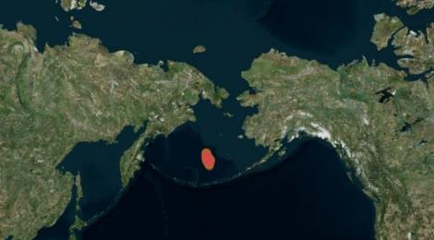


The Probability Matrix
Northern Azimuth Calculation Results: “Other” Locations
The remaining locations will be categorized as “Other” and will be examined in Section VIII.
Bering Sea
Coordinates:$56.50° N, −176.00° E$
Location Type: Other
Time Period: $N/A$
Jan Mayan Island
Coordinates:$71.08° N, −8.16° E$
Location Type: Other
Time Period: $N/A$

Slide 42
The Probability Matrix
Equatorial Proximity Calculation: Background
Because agriculture (farming) is a prerequisite to civilization, the earliest permanent human settlements would be located near the area where the farming of that civilization developed. These settlements would be the oldest of all archeological sites.
If agriculture/farming began during the last ice age, the ideal location for this (in terms of climate) would be at or near the equator. This is where the average temperature would be the warmest and the days would be the longest.
In addition, there would be a natural migration of humans towards the equator. This would occur independently and without the need for coordination with other groups of “people”; as each group would inevitably discover that warmer weather and longer days exist to the south (or north).
Therefore, the oldest archeological sites would be located on, or very near the equator (the equator at that time).

Slide 43

The Probability Matrix
Equatorial Proximity Calculation
Starting from $55° N$ and ending at $90° N$, a table of coordinates that increments every $.25° Latitude$and $.25° Longitude$ is generated. This table contains $203,181$ target coordinates that will be tested for equatorial proximity.
A target coordinate is a potential pole location for one or more archeological sites. The distance from a pole location to its equator is $\sim 10,000 km$.
For each coordinate, the distance between it and each of the $\sim 222$archeological sites is calculated. If the distance of a site is found to be between $9,875 and 10,125 km$, it is added to the total equatorial site count (site count) for that target coordinate.
The “probability” is the likelihood that the coordinate was once a pole location. This likelihood is quantified by the total site count of a target coordinate. Thus, the higher the site count, the more likely the target coordinate was once a pole location.

Slide 44


The Probability Matrix
Equatorial Proximity Calculation Results
Using $45,106,182$ test calculations, the probability matrix is generated. The matrix is truncated below its “peaks”; i.e., it retains the top $15\%$ (by site count).
The result is one ($1$) zone that accounts for almost all proximity overlaps. The image to the right shows the zone (in red).

Slide 45



The Probability Matrix
Equatorial Proximity Calculation Results: Yukon
The image to the right shows the probability of equatorial proximity in the Yukon zone. The center of this zone has the following coordinates:
$$60.10° N, −140.09° E$$

Slide 46


The Probability Matrix
Equatorial Proximity Calculation Results: Yukon Equator Sites
The image below shows the sites that are located on the equator of the Yukon pole location. Note that the sites form a curved line when connected, as opposed to a straight line. This is because this map represents a $three−dimensional$ object projected onto a $two−dimensional$ surface.

Slide 47

The Probability Matrix
Equatorial Proximity Calculation Results: Yukon Equator Sites
The image below shows some of the sites that are located on (or near) the equator of the Yukon pole location. This equator represents the “ley line” known as The Great Circle.

Slide 48

The Probability Matrix
Equatorial Proximity Calculation Results: Yukon Equator Sites
The image below shows some of the sites that are located on (or near) the equator of the Yukon pole location. This equator represents the “ley line” known as The Great Circle.

Slide 49

The Probability Matrix
Equatorial Proximity Calculation Results: Yukon Equator Sites
The image below shows some of the sites that are located on (or near) the equator of the Yukon pole location. This equator represents the “ley line” known as The Great Circle.

Slide 50

The Probability Matrix
Equatorial Proximity Calculation Results: Yukon Equator Sites
The image below shows some of the sites that are located on (or near) the equator of the Yukon pole location. This equator represents the “ley line” known as The Great Circle.

Slide 51


The Probability Matrix
Equatorial Proximity Calculation Results: Yukon Location
Yukon
Coordinates: $60.10° N, −140.09° E$
Location Type: Pole
Time Period: $\sim 100,000−72,000 BCE$

Slide 52




The Probability Matrix
Eastern Azimuth Calculation: Background
The eastern azimuth calculation will identify “alternate” equators. For any site that is aligned to a northern pole, there will be a corresponding eastern alignment angle. This angle is the northern azimuth plus $90$°.
$$Eastern Azimuth =Northern Azimuth + 90°$$
If this angle is increased slightly (or at all), the eastern alignment will intersect with the equator of the pole the site is aligned with.
Northern Pole
Northern Azimuth = $0°$
Eastern Azimuth = $90°$
Adjusted Eastern Azimuth = $90°+n$
Equator
Equator intersect

Slide 53
The Probability Matrix
Eastern Azimuth Calculation: Background
Each intersect represents a point on the equator. If two or more sites are aligned with a northern pole other than the current one, the line formed by these points will not be parallel with the current equator.
Current Northern Pole
Alternate Northern Pole
Alternate Northern Pole
Current Equator
intersect
Alternate Equator
intersect

Slide 54

The Probability Matrix
Eastern Azimuth Calculation
The eastern azimuth calculation uses the same basic calculations as the northern azimuth calculation.
Starting from $−40° N$ and ending at $40° N$, a table of coordinates that increments every $.1° Latitude$and $.1° Longitude$ is generated. This table contains $2,880,800$ target coordinates that will be tested for site alignments (intersects).
A target coordinate is a potential location along the equator (the equator at the time of site construction).
Each coordinate is tested with the calculated eastern azimuth (alignment angle) of each of the $\sim 222$archeological sites. If the site being tested is found to be “pointing” at or through the target coordinate (within a tolerance of $±.4°$), it is added to the list of equator intersect locations.
Using a tolerance of $±.4°$ is the equivalent of increasing the eastern azimuth. It will also effectively decrease the eastern azimuth angle to account for sites located to the south of the equator.

Slide 55



The Probability Matrix
Eastern Azimuth Calculation Results
The images below display the eastern azimuth intersect locations. Note that the zones form $2$ (two) distinct equators.
These equators correspond to the equators of the Yukon and Hudson Bay pole locations.

Slide 56


The Probability Matrix
Eastern Azimuth Calculation Results
The images below display the eastern azimuth intersect locations. Note that the zones form $2$ (two) distinct equators.
These equators correspond to the equators of the Yukon and Hudson Bay pole locations.

Slide 57


The Probability Matrix
Eastern Azimuth Calculation Results
The images below display the eastern azimuth intersect locations. Note that the zones form $2$ (two) distinct equators.
These equators correspond to the equators of the Yukon and Hudson Bay pole locations.

Slide 58

The Probability Matrix
Eastern Azimuth Calculation Results: Yukon Equator
The image below shows the equator of the Yukon pole location. Note the curved line, as opposed to a straight line. This is because this map represents a $three−dimensional$ object projected onto a $two−dimensional$ surface.

Slide 59


The Probability Matrix
Eastern Azimuth Calculation Results: Hudson Bay Equator
The image below shows the equator of the Hudson Bay pole location. Note the curved line, as opposed to a straight line. This is because this map represents a $three−dimensional$ object projected onto a $two−dimensional$ surface.

Slide 60

The Probability Matrix
Eastern Azimuth Calculation Results: Yukon and Hudson Bay Equators
The image below shows the equators of the Yukon and Hudson Bay pole locations. Note the curved line, as opposed to a straight line. This is because this map represents a $three−dimensional$ object projected onto a $two−dimensional$ surface.

Slide 61


The Probability Matrix
Eastern Azimuth Calculation Results: Yukon and Hudson Bay Equators
The images below show the Yukon and Hudson Bay equators.

Slide 62



The Probability Matrix
Eastern Azimuth Calculation Results: Yukon and Hudson Bay Equators
The images below show the Yukon and Hudson Bay equators.

Slide 63

The Probability Matrix
Eastern Azimuth Calculation Results: Yukon and Hudson Bay Equators
The image below shows one of the two “axis” locations of the Yukon/Hudson Bay equators. An axis location is where the equator lines intersect. Note its proximity to Easter Island.

Slide 64

The Probability Matrix
Eastern Azimuth Calculation Results: Yukon and Hudson Bay Equators
The image below shows one of the two “axis” locations of the Yukon/Hudson Bay equators. An axis location is where the equator lines intersect. Note its proximity to Mohenjo-Daro.

Slide 65


The Probability Matrix
Norwegian Sea Equator
The image below shows the equator of the Norwegian Sea pole location. Note the curved line, as opposed to a straight line. This is because this map represents a $three−dimensional$ object projected onto a $two−dimensional$ surface.

Slide 66

The Probability Matrix
Yukon, Hudson Bay, and Norwegian Sea Equators
The image below shows the equators of the Yukon, Hudson Bay, and Norwegian Sea pole locations. Note the curved line, as opposed to a straight line. This is because this map represents a $three−dimensional$ object projected onto a $two−dimensional$ surface.

Slide 67


The Probability Matrix
Yukon, Hudson Bay, and Norwegian Sea Equators
The images below show the Yukon, Hudson Bay, and Norwegian Sea equators.

Slide 68



The Probability Matrix
Yukon, Hudson Bay, and Norwegian Sea Equators
The images below show the Yukon, Hudson Bay, and Norwegian Sea equators.

Slide 69


The Probability Matrix
Yukon, Hudson Bay, and Norwegian Sea Equators
The images below show one of the “axis” locations of the Yukon/Hudson Bay/Norwegian Sea equators. An axis location is where equator lines intersect.

Slide 70


The Probability Matrix
Yukon, Hudson Bay, and Norwegian Sea Equators
The image below shows one of the “axis” locations of the Yukon/Hudson Bay/Norwegian Sea equators. An axis location is where equator lines intersect.

Slide 71


The Probability Matrix
Yukon, Hudson Bay, and Norwegian Sea Equators
The image below shows one of the “axis” locations of the Yukon/Hudson Bay/Norwegian Sea equators. An axis location is where equator lines intersect.

Slide 72


The Probability Matrix
Yukon, Hudson Bay, and Norwegian Sea Equators
The image below shows one of the “axis” locations of the Yukon/Hudson Bay/Norwegian Sea equators. An axis location is where equator lines intersect.

Slide 73





The Probability Matrix
Pole Location: Yukon
Coordinates:$60.10° N, −140.09° E$
Time Period:$\sim 100,000−72,000 BCE$
Calculation Results – Pole Locations
The Yukon location also corresponds to one of Hapgood’s proposed pole locations.
Therefore, the $3$ (three) locations that correspond to one of Hapgood's pole locations are the Yukon, Norwegian Sea, and Hudson Bay. These are in addition to the Current pole location.
Pole Location: Norwegian Sea
Coordinates: $71.04° N, −4.64° E$
Time Period:$\sim 72,000−48,000 BCE$
Pole Location: Hudson Bay
Coordinates:$60.07° N, −77.77° E$
Time Period:$\sim 48,000−10,000 BCE$
Pole Location: Current
Coordinates: $90° N, 0° E$
Time Period:$\sim 10,000 BCE−Current$

Slide 74

Section III: The Tri-Poles
The following section examines the proposed pole configuration (called The Tri-Poles) using $2$ (two) of the pole locations identified in Section II (as well as the current pole location). This configuration exhibits the “default” or “original” pole transition behavior. This behavior is comparable to that of a timer or pendulum.
https://en.wikipedia.org/wiki/Tripoli,_Greece

Slide 75


The Tri-Poles
The Polar Pendulum
Configuration Type | Time Period(s)
Pendulum | $\sim 100,000−72,000 BCE$ $$\sim 34,000 BCE−Current$$
This configuration functioned like a pendulum or a timer.
In this configuration, the poles would transition at steady and consistent intervals. Geological changes during transitions would occur over the entire planet, as opposed to concentrated areas.
Sudden transitions of the poles in this configuration could cause geological cataclysms such as earthquakes, flooding, and extreme climate change.
North

Slide 76

The Tri-Poles
The Northern Poles
Pole | Coordinates
Current | $$90° N,$$ $$0° E$$
Hudson Bay | $$60.07° N,$$ $$−77.77° E$$
Yukon | $$60.1° N,$$ $$−140.09° E$$
Center Axis | $$76.65° N,$$ $$−109.05° E$$
The Center Axis represents the single point that is of equal distance from each pole location.
North

Slide 77


The Tri-Poles
The Southern Poles
Pole | Coordinates
Current | -$90° S,$ $$−180° E$$
Hudson Bay | $$−60.07° S, 102.23° E$$
Yukon | $$−60.1° S,$$ $$39.9° E$$
Center Axis | $$−76.65° S,$$ $$70.95° E$$
The Center Axis represents the single point that is of equal distance from each pole location.
South

Slide 78


The Tri-Poles
The Northern and Southern Axis Triangle
The images below show the three north and south pole locations that form an equilateral triangle.
North
South

Slide 79






The Tri-Poles
The Northern Axis Triangle
The image to the right shows the three north pole locations. Each of the poles is located $5,000 kiloants$ ($30$° or $3,344 kilometers$) from the other two.
The Center Island of Atlantis is $5,000 ants$in diameter.
The Northern Poles Center Axis represents the single point that is of equal distance from each pole location.
$5,000 ka$ = $30$° = $3,344 km$
$$5,000 ka$$
$$5,000 ka$$
$$5,000 ka$$

Slide 80




The Tri-Poles
North
The Weinberg Angle (Weak Mixing Angle)
Current
Yukon
Hudson Bay
The image to the right shows how the symmetry of the pole locations resemble the model of the Weinberg Angle.
$$Weinberg Angle = θ_{W} ≅30°$$
$$\sin^{2} θ_{W}≅ .2229$$
$30$°
$30$°
Hudson Bay
Yukon
Current
South
https://en.wikipedia.org/wiki/Weinberg_angle

Slide 81


The Tri-Poles
North
The Vitruvian Man
Current
Yukon
Hudson Bay
The layout also visually resembles the Vitruvian Man sketch by Leonard da Vinci. No conceptual relationships have been found (so far). However, the angles of the outspread legs are $≅30°.$
$30$°
$30$°
Hudson Bay
Yukon
Current
South
https://en.wikipedia.org/wiki/Vitruvian_Man

Slide 82








The Tri-Poles
Pole Location Timeline: The Pendulum Swing
Pole Location: Yukon
Coordinates:$60.10° N, −140.09° E$
Time Period:$\sim 100,000−70,000 BCE$
$$4 \text{(}\text{next} \text{position}\text{)}$$
Pole Location: Current
Coordinates: $90° N, 0° E$
Time Period a:$\sim 70,000−40,000 BCE$
Time Period b:$\sim 10,000 BCE−Current$
$$1$$
$$2$$
Pole Location: Hudson Bay
Coordinates:$60.07° N, −77.77° E$
Time Period:$\sim 40,000−10,000 BCE$
$$3$$
The duration of each pole location is ~25,000 years with a $\sim 5,000−year$transition.

Slide 83

Section IV: The Thermo-Poles
The following section examines the proposed pole configuration (called The Thermo-Poles) using $2−3$ of the pole locations identified in Section II (as well as the current pole location). This configuration exhibits the behavior of a thermostat.
https://en.wikipedia.org/wiki/Thermopylae

Slide 84

The Thermo-Poles
Right in Two
The image to the right shows how the Tri-Poles were original divided in order to create the Thermo-Poles.
Right in Two

Slide 85


The Thermo-Poles
Mirroring
The images below show the locations of the Thermo-Poles conceptionally created through the mirroring of the Tri-Poles.
Current Pole Mirrored
Yukon Pole Mirrored

Slide 86


The Thermo-Poles
Mirroring
The images below show how the Tri-Poles are mirrored and transitioned (conceptionally) into the Thermo-Poles.

Slide 87


The Thermo-Poles
Mirroring
The images below show how the Tri-Poles are mirrored and transitioned (conceptionally) into the Thermo-Poles.

Slide 88


The Thermo-Poles
Mirroring
The images below show how the Tri-Poles are mirrored and transitioned (conceptionally) into the Thermo-Poles.
The Center Axis, which is located at the Hudson Bay pole location of the Tri-Poles, represents the single point that is of equal distance from each pole location.

Slide 89


The THERMO-Poles
The Polar Thermostat
Configuration Type | Time Period
Thermostat | $$\sim 72,000−48,000 BCE$$
This configuration functioned as a thermostat for specific areas of the Earth.
Transitioning/Pivoting from one pole location to another in this configuration effectively moves sites in these areas closer to (or further from) the equator. But the movement during the transition is primarily in the north-south direction.
Sudden transitions of the poles in this configuration would cause geological cataclysms such as earthquakes, flooding, and extreme climate change.
North

Slide 90

The THERMO-Poles
The Northern Locations
Pole | Coordinates
Yukon | $$60.1° N,$$ $$−140.09° E$$
Beaufort Sea | $$78.22° N,$$ $$−157.28° E$$
Current | $$90° N,$$ $$0° E$$
Norwegian Sea | $$71.04° N,$$ $$−4.64° E$$
Center Axis | $$60.07° N,$$ $$−77.77° E$$
The Center Axis represents the single point that is of equal distance from each pole location.
North

Slide 91


The THERMO-Poles
Thermostat Rest Positions
Pole | Coordinates
Yukon | $$60.1° N,$$ $$−140.09° E$$
Its likely that the only time the Thermo-Poles rest position was at the Yukon location was the moment the Tri-Poles was “converted’ to the Thermo-Poles, and the pole location transition towards the Norwegian Sea began.
Yukon Rest Position

Slide 92


The THERMO-Poles
Thermostat Rest Positions
Pole | Coordinates
Beaufort Sea | $$78.22° N,$$ $$−157.28° E$$
Currently, there is no geological evidence that the Beaufort Sea location was once a pole location. However, there is evidence of ancient site alignments to this location.
So, its possible that the Thermo-Poles rest position was only in the Beaufort Sea location long enough for sites to be constructed, but not long enough to leave any significant geological evidence.
Its also possible that this location (and others) were used for some “other” purpose when/if not used as a rest position.
Beaufort Sea Rest Position

Slide 93



The THERMO-Poles
Thermostat Rest Positions
Pole | Coordinates
Current | $$90° N,$$ $$0° E$$
Geological and archeological evidence suggests that the Norwegian Sea location served as the rest position of the Thermo-Poles for most of the time that the configuration was active.
The current north pole appears to be the $2nd$ most utilized rest position. However, this assumes sites aligned with the current north pole were constructed during the time the Thermo-Poles configuration was active.
Since this is most likely not the case, the duration of time the Thermo-Poles was in the rest position located at the current north pole cannot be assumed or directly derived.
Current Pole Rest Position

Slide 94


The THERMO-Poles
Thermostat Rest Positions
Pole | Coordinates
Norwegian Sea | $$71.04° N,$$ $$−4.64° E$$
Geological and archeological evidence suggests that the Norwegian Sea location served as the rest position of the Thermo-Poles for most of the time that the configuration was active.
The current north pole appears to be the $2nd$ most utilized rest position. However, this assumes sites aligned with the current north pole were constructed during the time the Thermo-Poles configuration was active.
Since this is most likely not the case, the duration of time the Thermo-Poles was in the rest position located at the current north pole cannot be assumed or directly derived.
Norwegian Sea Rest Position

Slide 95

The THERMO-Poles
Pivot Line:
The Zone of Kings
The image to the right shows the area (between the blue lines) where the movement from a pole transition is almost entirely north and south.
Western Pivot Line

Slide 96

The THERMO-Poles
Pivot Line:
The Zone of the Forgotten
The image to the right shows the area (between the blue lines) where the movement from a pole transition is almost entirely north and south.
Note the absence of any significant land mass.
Eastern Pivot Line

Slide 97
Section V: The Polar Ants
The following section examines how the varying elevations of the pole locations create different sizes of circumferences on the Earth, and subsequently create corresponding measurement systems.

Slide 98






The Polar Ants
Current (North)
$$elevation≅−6,341 a$$
$$(sea level)$$
Tri-Pole Locations
Yukon (North)
$$elevation≅+1,518 a$$
Hudson Bay (North)
$$elevation≅+117 a$$
The chart on the right shows the current absolute elevation information for the northern and southern Tri-Pole locations. The absolute elevation is the height from the ground or from the sea floor. The values are based on current GPS data.
Hudson Bay (South)
$$elevation≅−6,562 a$$
$$(sea level)$$
Yukon (South)
$$elevation≅−7,963 a$$
$$(sea level)$$
Antarctica
Current (South)
$$elevation≅+4,645 a$$

Slide 99








The Polar Ants
Current (North)
$$elevation≅−6,341 a$$
$$(sea level)$$
Thermo-Pole Locations
Yukon (North)
$$elevation≅+1,518 a$$
Norwegian Sea (North)
$$elevation≅−2,626 a$$
The chart on the right shows the current absolute elevation information for the northern and southern Thermo-Pole locations. The absolute elevation is the height from the ground or from the sea floor. The values are based on current GPS data.
Beaufort Sea (North)
$$elevation≅−2,686 a$$
Beaufort Sea (South)
$$elevation≅+5,340 a$$
Norwegian Sea (South)
$$elevation≅−3,400 a$$
$$(sea level)$$
Yukon (South)
$$elevation≅−7,963 a$$
$$(sea level)$$
Antarctica
Current (South)
$$elevation≅+4,645 a$$

Slide 100

The Polar Ants
Calibration Value: Definition
A calibration value is the baseline number a measurement system uses to derive its ratio to another measurement system. It is based on the measurement of a well-known distance. In this case, the measurement is of the antediluvian equatorial circumference of the Earth at the Hudson Bay pole location.
Therefore, the calibration value of a measurement system is equal to the antediluvian equatorial circumference of the Earth (measured in that system) while in the Hudson Bay axis position.
For example, the calibration value for the ant is $60,000,000$ and the calibration value for the meter is $40,047,405$. Another example is the sacred cubit’s calibration value of $63,000,000$.

Slide 101

The Polar Ants
Pole Locations - Antediluvian Radius
The table below displays the equatorial and virtual polar radius (and circumference) for each axis position (pole location). The values are displayed in ants and represent the antediluvian size of the Earth (adjusted for sea levels).
Axis Position | Equatorial Radius | Polar Radius
Current | $$9,539,675 a$$ | $$9,523,810 a$$
Hudson Bay | $$9,549,297 a$$ | $$9,514,188 a$$
Yukon | $$9,549,297 a$$ | $$9,523,810 a$$
Norwegian Sea | $$9,531,391 a$$ | $$9,514,188 a$$
Beaufort Sea | $$9,549,297 a$$ | $$9,531,391 a$$

Slide 102

The Polar Ants
Pole Locations - Antediluvian Circumference
The table below displays the equatorial and virtual polar radius (and circumference) for each axis position (pole location). The values are displayed in ants and represent the antediluvian size of the Earth (adjusted for sea levels).
Axis Position | Equatorial Circumference | Virtual Polar Circumference
Current | $$59,939,546 a$$ | $$59,839,863 a$$
Hudson Bay | $$60,000,000 a$$ | $$59,779,406 a$$
Yukon | $$60,000,000 a$$ | $$59,839,863 a$$
Norwegian Sea | $$59,887,496 a$$ | $$59,779,406 a$$
Beaufort Sea | $$60,000,000 a$$ | $$59,887,496 a$$

Slide 103

The Polar Ants
True Polar Circumference
The virtual polar circumference is calculated as follows:
$$Virtual Polar Circumference= 2∙π∙R_{polar}$$
However, the “true” polar circumference is calculated using both the polar and equatorial radius. The true polar circumference is the total length of the perimeter of a great circle that is perpendicular to the equator. The value can be derived using the formula below:
$$R_{true polar}=\frac{{(3∙(R}_{polar}+R_{equatorial}))−\sqrt{{((3∙R}_{equatorial})+R_{polar})∙{((3∙R}_{polar})+R_{equatorial})}}{2}$$
$$True Polar Circumference= 2∙π∙R_{true polar}$$
This formula was developed by Srinivasa Ramanujan.
https://en.wikipedia.org/wiki/Srinivasa_Ramanujan

Slide 104

The Polar Ants
Pole Location Radius
The table below displays the complete radius information for each pole location. The values are displayed in ants.
Axis Position | Eq. Radius | Polar Radius | True Polar Radius
Current | $$9,539,675 a$$ | $$9,523,810 a$$ | $$9,531,391 a$$
Hudson Bay | $$9,549,297 a$$ | $$9,514,188 a$$ | $$9,531,391 a$$
Yukon | $$9,549,297 a$$ | $$9,523,810 a$$ | $$9,536,880 a$$
Norwegian Sea | $$9,531,391 a$$ | $$9,514,188 a$$ | $$9,523,810 a$$
Beaufort Sea | $$9,549,297 a$$ | $$9,531,391 a$$ | $$9,539,675 a$$

Slide 105

The Polar Ants
Pole Location Circumference
The table below displays the complete circumference information for each pole location. The values are displayed in ants.
Axis Position | Eq. Circumference | Polar Circumference | True Polar Circumference
Current | $$59,939,546 a$$ | $$59,839,863 a$$ | $$59,887,496 a$$
Hudson Bay | $$60,000,000 a$$ | $$59,779,406 a$$ | $$59,887,496 a$$
Yukon | $$60,000,000 a$$ | $$59,839,863 a$$ | $$59,921,984 a$$
Norwegian Sea | $$59,887,496 a$$ | $$59,779,406 a$$ | $$59,839,863 a$$
Beaufort Sea | $$60,000,000 a$$ | $$59,887,496 a$$ | $$59,939,546 a$$

Slide 106


The Polar Ants
Pole Location Radius and Circumference
Using each unique equatorial, polar, and true polar circumference, create a new measurement system by dividing each circumference by $60,000,000$. The result is the ratio of the new measurement system to the “original” ant measurement system (which will be referred to as the “gravity ant” for the rest of this document).
Each new measurement system will represent a circumference of $60,000,000$. The table below shows the calculation using the current axis position as an example.
Axis Position | Eq. Circumference | Polar Circumference | True Polar Circumference
Current | $$\frac{59,939,546}{60,000,000}=.99899243$$ | $$\frac{59,839,863}{60,000,000}=.99733105$$ | $$\frac{59,887,496}{60,000,000}=.99812493$$

Slide 107

The Polar Ants
Pole Location Radius and Circumference
Next, multiply the inverse of the ratio by $60,000,000$.
Axis Position | Eq. Circumference | Polar Circumference | True Polar Circumference
Current | $$.99899243→1.001008$$ $$1.001008∙60,000,000=60,060,515$$ | $$.99733105→1.0026760$$ $$1.0026760∙60,000,000=60,160,560$$ | $$.99812493→1.0018786$$ $$1.0018786∙60,000,000=60,112,694$$

Slide 108

The Polar Ants
Pole Location Radius and Circumference
This number represents the antediluvian equatorial circumference of the Earth (at the Hudson Bay axis) in that new measurement system. This number will also represent the new system’s calibration value.
Axis Position | Eq. Circumference | Polar Circumference | True Polar Circumference
Current Location | $$60,060,515$$ | $$60,160,560$$ | $$60,112,694$$
Hudson Bay | $$60,000,000$$ | $$60,221,408$$ | $$60,112,694$$
Yukon | $$60,000,000$$ | $$60,160,560$$ | $$60,078,118$$
Norwegian Sea | $$60,112,694$$ | $$60,221,408$$ | $$60,160,560$$
Beaufort Sea | $$60,000,000$$ | $$60,112,694$$ | $$60,060,515$$

Slide 109







The Polar Ants
The Six Ants
From these calibration values, six measurement systems can be defined. One is the gravity ant, which is the original or “common” ant unit.
Measurement System | Abbreviation | Calibration Value | Ratio to Gravity Ant
Gravity Ant | a | $$60,000,000$$ | $$1:1$$
Earth Ant | ea | $$60,060,515$$ | $$.99899243$$
Stone Ant | sa | $$60,078,118$$ | $$.99869853$$
Light Ant | la | $$60,112,694$$ | $$. 99812493$$
Pyramid Ant | pa | $$60,160,560$$ | $$.99733105$$
Avogadro Ant | ava | $$60,221,408$$ | $$.99632343$$

Slide 110

The Polar Ants
The Ratio of the Six Ants
The ratios between the six ($6$) ant systems can be applied to other measurement systems. For example, the table below displays the six ($6$) scared cubit “variations” created by these ratios.
Measurement System | Calibration Value | Ratio to Sacred Cubit
Sacred Cubit | $$63,000,000$$ | $$1:1$$
Earth Ant Ratio | $$63,063,541$$ | $$.99899243$$
Stone Ant Ratio | $$63,082,024$$ | $$.99869853$$
Light Ant Ratio | $$63,118,329$$ | $$. 99812493$$
Pyramid Ant Ratio | $$63,168,588$$ | $$.99733105$$
Avogadro Ant Ratio | $$63,232,478$$ | $$.99632343$$
Any one of these variations may have been used as the “official” size of the sacred cubit at some point.

Slide 111
The Polar Ants
The Ratio of the Six Ants
One possibility is that the “official” size of the sacred cubit (and other measurement systems) was dependent upon the current axis position of the Earth. This would create varying sizes of the same unit of measure within the archeological record.
Measurement System | Calibration Value | Ratio to Sacred Cubit
Sacred Cubit | $$63,000,000$$ | $$1:1$$
Earth Ant Ratio | $$63,063,541$$ | $$.99899243$$
Stone Ant Ratio | $$63,082,024$$ | $$.99869853$$
Light Ant Ratio | $$63,118,329$$ | $$. 99812493$$
Pyramid Ant Ratio | $$63,168,588$$ | $$.99733105$$
Avogadro Ant Ratio | $$63,232,478$$ | $$.99632343$$

Slide 112

The Polar Ants
Axis Position Measurements
The following slides display the “size” of each of the six ($6$) ant systems while in the different axis positions. The measured radius of the equatorial, polar, and true polar distances each reflect the base calibration value of the measurement system (when measured with their respective system values/ratios).
For example, the base calibration value of the ant is $60,000,000$.
While in the Hudson Bay axis position, the equatorial circumference of the Earth, in gravity ants, is $60,000,000$.
In the same position, the polar (virtual) circumference of the Earth, in pyramid ants, is $60,000,000$.
And finally, the true polar circumference of the Earth, in stone ants, is $60,000,000$ (in the same axis position).
Note that all three ($3$) of the above systems have different calibration values. And because of this (and their ratios), their measured values are all equal (numerically).

Slide 113

The Polar Ants
Hudson Bay Axis Position Measurements
The table below shows the antediluvian Earth circumference measurements while in the Hudson Bay axis position.
Measurement System | Equatorial Circumference | True Polar Circumference | Virtual Polar Circumference
Gravity Ant (a) | $$60,000,000 ✓$$ | $$59,921,912$$ | $$59,839,860$$
Earth Ant (ea) | $$60,060,515$$ | $$59,982,348$$ | $$59,900,213$$
Stone Ant (sa) | $$60,078,118$$ | $$60,000,000 ✓$$ | $$59,917,769$$
Light Ant (la) | $$60,112,694$$ | $$60,034,481$$ | $$59,952,275$$
Pyramid Ant (pa) | $$60,160,560$$ | $$60,082,263$$ | $$60,000,000 ✓$$
Avogadro Ant (ava) | $$60,221,408$$ | $$60,143,032$$ | $$60,060,677$$

Slide 114

The Polar Ants
Current Axis Position Measurements
The table below shows the antediluvian Earth circumference measurements while in the current axis position.
Measurement System | Equatorial Circumference | True Polar Circumference | Virtual Polar Circumference
Gravity Ant (a) | $$59,939,546$$ | $$59,891,668$$ | $$59,839,860$$
Earth Ant (ea) | $$60,000,000 ✓$$ | $$59,952,074$$ | $$59,900,213$$
Stone Ant (sa) | $$60,017,586$$ | $$59,969,645$$ | $$59,917,769$$
Light Ant (la) | $$60,052,149$$ | $$60,000,000 ✓$$ | $$59,952,275$$
Pyramid Ant (pa) | $$60,099,945$$ | $$60,051,938$$ | $$60,000,000 ✓$$
Avogadro Ant (ava) | $$60,160,731$$ | $$60,112,694$$ | $$60,060,677$$

Slide 115

The Polar Ants
Yukon Axis Position Measurements
The table below shows the antediluvian Earth circumference measurements while in the Yukon axis position.
Measurement System | Equatorial Circumference | True Polar Circumference | Virtual Polar Circumference
Gravity Ant (a) | $$60,000,000 ✓$$ | $$59,891,708$$ | $$59,779,406$$
Earth Ant (ea) | $$60,060,515$$ | $$59,952,114$$ | $$59,839,699$$
Stone Ant (sa) | $$60,078,118$$ | $$59,969,685$$ | $$59,857,237$$
Light Ant (la) | $$60,112,694$$ | $$60,000,000 ✓$$ | $$59,891,708$$
Pyramid Ant (pa) | $$60,160,560$$ | $$60,051,979$$ | $$59,939,376$$
Avogadro Ant (ava) | $$60,221,408$$ | $$60,112,694$$ | $$60,000,000 ✓$$

Slide 116

The Polar Ants
Norwegian Sea Axis Position Measurements
The table below shows the antediluvian Earth circumference measurements while in the Norwegian Sea axis position.
Measurement System | Equatorial Circumference | True Polar Circumference | Virtual Polar Circumference
Gravity Ant (a) | $$59,887,496$$ | $$59,835,416$$ | $$59,779,406$$
Earth Ant (ea) | $$59,947,897$$ | $$59,895,765$$ | $$59,839,699$$
Stone Ant (sa) | $$59,965,467$$ | $$59,913,320$$ | $$59,857,237$$
Light Ant (la) | $$60,000,000 ✓$$ | $$59,947,823$$ | $$59,891,708$$
Pyramid Ant (pa) | $$60,047,755$$ | $$60,000,000 ✓$$ | $$59,939,376$$
Avogadro Ant (ava) | $$60,108,489$$ | $$60,056,217$$ | $$60,000,000 ✓$$

Slide 117

The Polar Ants
Beaufort Sea Axis Position Measurements
The table below shows the antediluvian Earth circumference measurements while in the Beaufort Sea axis position.
Measurement System | Equatorial Circumference | True Polar Circumference | Virtual Polar Circumference
Gravity Ant (a) | $$60,000,000 ✓$$ | $$59,945,717$$ | $$59,887,496$$
Earth Ant (ea) | $$60,060,515$$ | $$60,000,000 ✓$$ | $$59,947,897$$
Stone Ant (sa) | $$60,078,118$$ | $$60,023,765$$ | $$59,965,467$$
Light Ant (la) | $$60,112,694$$ | $$60,058,331$$ | $$60,000,000 ✓$$
Pyramid Ant (pa) | $$60,160,560$$ | $$60,106,132$$ | $$60,047,755$$
Avogadro Ant (ava) | $$60,221,408$$ | $$60,166,925$$ | $$60,108,489$$

Slide 118
The Polar Ants
The True Polar System
The measurement systems used for the true polar circumference represent the vertical (latitude) component of a coordinate system.
In other words, the true polar system evenly divides the polar circumference so that the degrees of latitude are proportional to the size of the true polar ant.
This makes the true polar systems ideal for measuring distances on the surface of the earth. It also can be used in conjunction with the gravity ant to calculate very precise geodetic distances/curves.

Slide 119



The Polar Ants
The Avogadro Ant and the Avogadro Constant
The calibration value for the Avogadro ant has the same numerical value as the Avogadro constant, which is $6.02214076∙{10}^{23}$. This is a fundamental constant in physics/chemistry and relates to quantities of particles and the mol.
$$Avogadro Constant=6.02214076×{10}^{23}$$
Measurement System | Abbreviation | Calibration Value | Ratio to Gravity Ant
Avogadro Ant | ava | $$60,221,407.6$$ | $$.99632343$$
The Avogadro ant ($cal. val=60,221,408$) creates a true polar circumference that is equal to the light ant ($cal. val=60,112,694$), when the gravity ant ($cal. value=60,000,000$) represents the equatorial circumference.
$$60,221,407.6≽60,000,000≑60,112,694$$
https://en.wikipedia.org/wiki/Avogadro_constant

Slide 120

The Polar Ants
The Speed of the Light Ant
The size of the light ant “evens-out” the speed of light. This is done by contracting the distance unit size (which increases the calibration value).
Recall that the numerical value for the gravitational constant ($G$) in gravity ants is “non-fractional”:
$$G=1.00∙{10}^{−10}$$
Measurement System | Abbreviation | Calibration Value | Ratio to Gravity Ant
Light Ant | la | $$60,112,694$$ | $$.99812493$$
https://en.wikipedia.org/wiki/Speed_of_light

Slide 121


The Polar Ants
The Speed of the Light Ant
Because of the contracted unit size of the light ant, its numerical value for the speed of light ($c$) is a “non-fractional” number as well. And just as the speed of light is constant, so is the light ant (as the only true polar circumference).
The table below shows the speed of light ($c$) values for the gravity ant and light ant.
Measurement System | Calibration Value | Speed of Light Value
Gravity Ant | $$60,000,000$$ | $$c=449,156,885 a/s$$
Light Ant | $$60,112,694$$ | $$c=450,000,000 {la}/s$$
Note the inverse of the speed of light:
$$4.50∙{10}^{8}→2.2222∙{10}^{−9}$$
https://en.wikipedia.org/wiki/Speed_of_light

Slide 122
The Polar Ants
Antediluvian vs. Current Equatorial Circumference
Antediluvian vs. current equatorial circumference of the Earth in meters (current axis position). A significant rise in sea levels can account for the difference.
Measurement System | Antediluvian | Current (2022) | Difference
Meters (m) | $$40,007,055$$ | $$40,075,017$$ | $$67,962$$
The antediluvian circumference of the Earth in gravity ants (current axis position).
Measurement System | Equatorial Circumference | True Polar Circumference | Virtual Polar Circumference
Gravity Ant (a) | $$59,939,546$$ | $$59,887,496$$ | $$59,839,860$$

Slide 123



The Polar Ants
The Ants to Sacred Cubits Ratio
Recall the antediluvian equatorial circumference of the Earth in sacred cubits (Yukon and Hudson Bay axis positions) is $63,000,000 sc$. This is its calibration value.
$${Circumference}_{Earth}^{equatorial}=6.300000×{10}^{7} sacred cubits=63,000,000$$
Measurement System | Calibration Value | Virtual Polar Radius (Current Axis Position)
Gravity Ant (a) | $$60,000,000$$ | $$9,523,809.52 a$$
Sacred Cubit (sc) | $$63,000,000$$ | $$10,000,000 sc$$
The virtual polar circumference of the Earth (current axis position) is $59,839,860 a$, which is a radius of $9,523,809.52 a$. This value is equal to the gravity ant-to-sacred cubit ratio of ${60}/{63}$.
$${60}/{63}=.952380952 (×1,000,000)=9,523,809.52 a=6,356,731 m (meters)$$
$$6,356,731 m=Current \left(2022\right) Polar Radius of Earth$$

Slide 124

The Polar Ants
The Hudson Bay Measurement System Factory
The Hudson Bay axis position can be used to “create” measurement systems. The polar and equatorial radii at this pole location align the calibration values of both the radius-based and the circumference-based systems.
Recall that the equatorial circumference at the Hudson Bay axis position is used as the baseline for calibration values. Therefore, in order to create a circumference-based measurement system, simply assign the desired circumference as the calibration value.
The table below displays the calibration information for a measurement system called the “$yax’xu$” (blue ant), which is based on a $48,000,000−$unit equatorial circumference. This system will be discussed in $Part III$.
Measurement System | Desired Equatorial Circumference | Calibration Value
$$Yax^{′}xu (yx)$$ | $$48,000,000 yx$$ | $$48,000,000$$

Slide 125



The Polar Ants
The Hudson Bay Measurement System Factory
Because of the ratio between the equatorial and polar radii (ellipticity/flattening), the polar radius (virtual) of the new created measurement system can by calculated by dividing the calibration value by $6.3$.
Measurement System | Calibration Value | Polar Radius
$$Yax^{′}xu (yx)$$ | $$48,000,000$$ | $$48,000,000÷6.3=$$ $$7,619,048 yx$$
Note that $1 yax’xu≅83 cm$. This is equal to the unit of measurement determined to be used in the construction of the ancient site located at Teotihuacan, Mexico.
https://news.asu.edu/content/asu-archaeologist-determines-standard-unit-measurement-ancient-mesoamerican-city

Slide 126


The Polar Ants
The Hudson Bay Measurement System Factory
For radius-based systems, the calibration value can be calculated by multiplying the desired radius (virtual) by $6.3$. The table below demonstrates how to calculate the calibration value for a measurement system based on a $48,000,000$-unit polar radius.
Measurement System | Desired Polar Radius | Calibration Value
$$Radius Yax^{′}xu (ryx)$$ | $$48,000,000 ryx$$ | $$48,000,000×6.3=$$ $$302,400,000$$
Note that the calibration value (which is also the equatorial circumference) is an even or “non-fractional” number.

Slide 127

The Polar Ants
The Hudson Bay Measurement System Factory
Both the sacred cubit and the Olympic stadion are radius-based measurement systems. The table below demonstrates how they are “created”.
Measurement System | Desired Polar Radius | Calibration Value (Equatorial Circumference)
$$Sacred Cubit$$ | $$10,000,000$$ | $$10,000,000×6.3=$$ $$63,000,000$$
$$Olympic Stadion$$ | $$36,000,000$$ | $$36,000,000×6.3=$$ $$226,800,000$$

Slide 128
Section VI: The Grid
The following section examines the parallel and meridian grid line layout (global grid) of the each of the pole locations. The grids illustrate how the different pole locations (axis positions) create different relative positions of the same geological locations.

Slide 129


The Grid
Yukon
The images below show the north and south locations for the Yukon pole.
North
South

Slide 130


The Grid
Yukon
The images below show the parallel and meridian grid lines of the Yukon pole projected onto the surface of the Earth.

Slide 131


The Grid
Yukon
The images below show the parallel and meridian grid lines of the Yukon pole projected onto the surface of the Earth.

Slide 132


The Grid
Hudson Bay
The images below show the north and south locations for the Hudson Bay pole.
North
South

Slide 133


The Grid
Hudson Bay
The images below show the parallel and meridian grid lines of the Hudson Bay pole projected onto the surface of the Earth.

Slide 134


The Grid
Hudson Bay
The images below show the parallel and meridian grid lines of the Hudson Bay pole projected onto the surface of the Earth.

Slide 135


The Grid
Current Pole Location
The images below show the current north and south pole locations.
North
South

Slide 136


The Grid
Current Pole Location
The images below show the parallel and meridian grid lines of the current pole location projected onto the surface of the Earth.

Slide 137


The Grid
Norwegian Sea
The images below show the north and south locations for the Norwegian Sea pole.
North
South

Slide 138


The Grid
Norwegian Sea Pole Location
The images below show the parallel and meridian grid lines of the Norwegian Sea pole location projected onto the surface of the Earth.

Slide 139


The Grid
All Pole Locations: Tri-Poles
The images below show the parallel and meridian grid lines of all the Tri-Pole locations projected onto the surface of the Earth.

Slide 140


The Grid
All Pole Locations: Tri-Poles
The images below show the parallel and meridian grid lines of all the Tri-Pole locations projected onto the surface of the Earth.

Slide 141


The Grid
All Pole Locations: Tri-Poles
The images below show the parallel and meridian grid lines of all the Tri-Pole locations projected onto the surface of the Earth.

Slide 142


The Grid
All Pole Locations: Tri-Poles
Note the visual resemblance of the grid overlays to illustrations of theoretical Earth energy/ley lines.
Tri-Pole Location Gids
Earth Energy/Ley Lines

Slide 143


The Grid
All Pole Locations: Thermo-Poles
The images below show the parallel and meridian grid lines of all the Thermo-Pole locations projected onto the surface of the Earth.

Slide 144


The Grid
All Pole Locations: Thermo-Poles
The images below show the parallel and meridian grid lines of all the Thermo-Pole locations projected onto the surface of the Earth.

Slide 145
Section VII: The Hudson Bay Offset
The following section examines the relative position of Atlantis while the north pole was in the Hudson Bay axis position. This was also the same time period (given by Plato) that Atlantis was “destroyed”.

Slide 146

The Hudson Bay Offset Hudson Bay & Atlantis
Atlantis Relative Location
Straits of Gibraltar
The image to the left shows the location of Atlantis with the parallel and meridian grid lines of the Hudson Bay pole projected onto the surface of the Earth.
Note that on this grid, Atlantis is located to the west of the Straits of Gibraltar. This location places Atlantis at the same relative position given by Plato.
https://en.wikipedia.org/wiki/Isostasy

Slide 147

The Hudson Bay Offset Hudson Bay & Atlantis
Atlantis Relative Location
Straits of Gibraltar
A shift of $30°$ from the current position to the Hudson Bay position would change (raise and lower) sea levels over the entire planet, as well as alter the “shape” of the shorelines.
And because of the “relocation” of the equator, which would relocate massive amounts of water, there would be a modest adjustment made to the isostatic equilibrium between the Earth’s crust (lithosphere) and mantle.
The gradual relocation of the polar ice sheets would also have a significant effect on global isostatic equilibrium.
https://en.wikipedia.org/wiki/Isostasy

Slide 148
The Hudson Bay Offset Hudson Bay & Atlantis
Atlantis Relative Location
Straits of Gibraltar
This could raise the sea levels around the land mass of Atlantis and form an island.
Moving from the Hudson Bay axis position would then have the opposite effect. The isostatic rebound eventually “raising” the land mass of Atlantis out of the sea and forming (or joining) the Sahara Desert, where it is currently located.
A sudden and very rapid shift from the Hudson Bay position to the current position would “push” Atlantis (and massive amounts of water) towards the equator.
https://en.wikipedia.org/wiki/Isostasy

Slide 149
The Hudson Bay Offset Hudson Bay & Atlantis
Atlantis Relative Location
Straits of Gibraltar
This sudden movement of land and water would cause the seas to wash over the land like an enormous tsunami, causing Atlantis to (temporarily) drop below sea level.
Therefore, Atlantis would have technically been destroyed by flooding, as opposed to by sinking.
https://en.wikipedia.org/wiki/Isostasy

Slide 150
Section VIII: The Other
The following section examines the locations identified as Other in Section II. Some of these locations closely resemble the descriptions of ancient mythological cities. This section assigns the names of these mythological cities to some of the locations identified as Other. However, these are “proposed” identifications and further investigation is needed.

Slide 151


The Other
The Prime Meridian Indicators
A Prime Meridian Indicator (PMI) is physical object that maintains a constant position relative to the active pole location. This is done in order to serve as indicator (or marker) for the active prime meridian.
This object can be located on the surface of the Earth, or it could be a stellar object such as a star or satellite in a geosynchronous orbit (natural or otherwise).
The same physical object can serve as a PMI for more than one pole location. Therefore, these objects move from one location to another during a pole transition.
PMIs are located exactly $19.00$° from each potential pole location.

Slide 152

The Other
The Lantis
Locations categorized as “Other” will be recategorized as “Lantis” sites. A Lantis is a location near an active or inactive pole location. A Lantis can have one or more functions (which will be examined in this section). For example, some Lantis sites are inactive pole locations that indicate the prime meridian.

Slide 153



The Greenland Lantis
Greenland Probability Zone
The center of the Greenland probability zone has the following coordinates:
$$79.75° N, −63.75° E$$
Note the circular formation to the southwest of the zone.
The center of the formation has the following coordinates:
$$78.72° N, −66.146° E$$

Slide 154



The Greenland Lantis
The Greenland “Crater”
In $2015$, a circular structure was discovered emerging from the Hiawatha Glacier in Greenland. Geologists have theorized that the structure could be an impact crater from an asteroid that struck the Earth around $58,000,000 BCE$. Initial estimates were at ~$10,000 BCE$.
https://www.science.org/content/article/massive-crater-under-greenland-s-ice-points-climate-altering-impact-time-humans

Slide 155

The Greenland Lantis
The Greenland “Crater”
Geologists infer the age of the crater by analyzing the zircon crystals and argon gas trapped in the sand and rocks. Using radioactive dating, scientists determined the formation of the crater occurred around $58,000,000$years ago.
Sediments from the crater, carried out by a stream, show signs of extreme heat and “shock”. Scientists claim this is evidence of a massive impact.
However, this is only evidence of extreme heat and pressure, which does not necessarily require the impact of a celestial object.
https://www.science.org/content/article/massive-crater-under-greenland-s-ice-points-climate-altering-impact-time-humans

Slide 156



The Greenland Lantis
The Greenland “Crater”
Using an ice-penetrating radar system, researchers were able to detect $5$ (five) prominent “bumps” in the crater's center, indicating a central peak rising $\sim 75 a$ ($50 m$) high.
This matches the elevation profile of Atlantis. The image below shows the elevation profile of Atlantis, having $4−5$ prominent “bumps” and a central peak rising $\sim 80 a$($53 m$) in elevation.
https://www.science.org/content/article/massive-crater-under-greenland-s-ice-points-climate-altering-impact-time-humans

Slide 157



The Greenland Lantis
The Greenland “Crater” – Formation Diameter
The Greenland formation is approximately $54 ka$ ($36 km$) in diameter. The areas at/near the crater show signs of exposure to extremely high temperatures.
54 ka/36 km
Greenland formation diameter: $54 kiloants.$

Slide 158



The Greenland Lantis
Atlantis – Formation Diameter
The diameter of the crater formation in Greenland is the same diameter as the “outer wall” of Atlantis.
54 ka/36 km
Atlantis “sea wall” diameter: $54 kiloants.$

Slide 159


The Greenland Lantis
The Greenland “Crater” - Zones
The formation is approximately $54 ka$ ($36 km$) in diameter. The areas at/near the crater show signs of exposure to extremely high temperatures.
54 ka/36 km
Greenland formation diameter: $54 kiloants.$

Slide 160

The Greenland Lantis
Atlantis - Zones
The diameter of the crater formation in Greenland is the same diameter as the “outer wall” of Atlantis.
54 ka/36 km
Atlantis “sea wall” diameter: $54 kiloants.$

Slide 161

The Greenland Lantis
Hyperborea
In Greek mythology, the Hyperboreans were a mythical people who lived in the far northern part of the known world. Their name appears to derive from the Greek, "beyond Boreas" (the personified North Wind).
Despite their location in an otherwise frigid part of the world, the Hyperboreans were believed to inhabit a sunny, temperate, and divinely-blessed land. In many versions of the story, they lived north of the Riphean Mountains, which shielded them from the effects of the cold North Wind.
The oldest myths portray them as the favorites of Apollo, and some ancient Greek writers regarded the Hyperboreans as the mythical founders of Apollo's shrines at Delos and Delphi.
https://en.wikipedia.org/wiki/Hyperborea

Slide 162

The Greenland Lantis
Hyperborea
Several legends/myths have linked Atlantis with Hyperborea. These include stories of a failed attempt by the Atlanteans to conquer the Hyperboreans.
Most end with the destruction of Atlantis and/or Hyperborea.
https://en.wikipedia.org/wiki/Hyperborea

Slide 163




The Greenland Lantis
Greenland, Plato, and Atlantis
Plato gave the following measurements for the entire island/country of Atlantis.
$$Width=3,000 stadia \left(ka\right)$$
$$Height=2,000 stadia (ka)$$
Greenland has approximately the same measurements.
$$\sim 2,000 ka$$
$$\sim 3,000 ka$$
https://en.wikipedia.org/wiki/Hyperborea

Slide 164


The Greenland Lantis
Greenland Lantis Location: Hyperborea
Note that the Greenland Lantis location is exactly $19.00° (3,169 ka)$from the Hudson Bay pole location. Therefore, Hyperborea possibly functioned as a Prime Meridian Indicator.
$$19.00°$$
$$3,169 ka$$

Slide 165


The Greenland Lantis
Greenland Lantis Location: Hyperborea
Hyperborea
Coordinates: 𝟕𝟖.𝟕𝟐° 𝑵, −𝟔𝟔.𝟏𝟒𝟔° 𝑬
Location Type: Lantis, Hyperborea, PMI
Time Period: $\sim 100,000−10,000 BCE$

Slide 166


The Hudson Bay Crater Lantis
Atlantis Solar System Layout
The images below show Atlantis at the center of a layout of the solar system. The layout uses the average orbits of each planet. Pluto is included in the layout and is represented by the outermost orbit. The radius of each orbit is measure in kiloants, which is the same unit as the Atlantis Zones layout.
Kuiper Belt Boundary
Kuiper Belt Boundary

Slide 167


The Hudson Bay Crater Lantis
Hudson Bay Crater Solar System Layout
The images below show the Hudson Bay Crater at the center of a layout of the solar system. The layout uses the average orbits of each planet. Pluto is included in the layout and is represented by the outermost orbit. The radius of each orbit is measure in kiloants, which is the same unit as the Atlantis Zones layout. Note how the orbit of Pluto aligns almost exactly with the outer rim of the crater.
Kuiper Belt
Boundary
Kuiper Belt
Boundary

Slide 168

The Hudson Bay Crater Lantis
Hudson Bay Crater Solar System Layout
Note the alignment of the Kuiper Belt boundary (white) with the edge of the Hudson Bay crater.
Kuiper Belt
Boundary

Slide 169


The Hudson Bay Crater Lantis
Hudson Bay Crater Lantis Location
Note that the Hudson Bay crater is $3.5° (583 ka)$from the Hudson Bay pole location. Recall that the P-Ratio for the maximum orbital radius of Mercury is $3.5$.
$$3.5°$$
$$583 ka$$

Slide 170

The Hudson Bay Crater Lantis
Aztlán
Aztlán is the ancestral home of the Aztec peoples. Aztlán is mentioned in several ethnohistorical sources dating from the colonial period, and while they each cite varying lists of the different tribal groups who participated in the migration from Aztlán to central Mexico, the Mexica who went on to found Mexico-Tenochtitlan are mentioned in all the accounts.
In most accounts, Aztlán was in the center of a large lake. In his book "Fragmentos de la Obra General Sobre Historia de los Mexicanos", Cristobal del Castillo mentions that the lake around the Aztlán island was called Metztliapan or "Lake of the Moon."
https://en.wikipedia.org/wiki/Aztl%C3%A1n

Slide 171

The Hudson Bay Crater Lantis
Aztlán
The meaning of the name Aztlán is uncertain. One suggested meaning is "place of whiteness". Other suggestions include "place of Herons", "place of egrets", and "at the place in the vicinity of tools".
Historians have speculated about the possible location of Aztlán and tend to place it either in northwestern Mexico or the southwest US.
https://en.wikipedia.org/wiki/Aztl%C3%A1n

Slide 172


The Hudson Bay Crater Lantis
Hudson Bay Crater Lantis Location: Aztlán
Aztlán
Coordinates: $56.73° N, −80.08° E$
Location Type: Lantis, Aztlán
Time Period:$Unknown$

Slide 173


The Lantis of the Norwegian Sea Pole
Hy-Brasil Lantis Location
Note that the location of Hy-Brasil is exactly $19.00° (3,169 ka)$from the Norwegian Sea pole location. Therefore, Hy-Brasil possibly functioned as a Prime Meridian Indicator.
$$19.00°$$
$$3,169 ka$$

Slide 174

The Lantis of the Norwegian Sea Pole
Hy-Brasil
Hy-Brasil, also known as Brasil and several other variants, is a phantom island said to lie in the Atlantic Ocean west of Ireland. Irish myths described it as cloaked in mist except for one day every seven years, when it becomes visible but still cannot be reached.
The etymology of the names Brasil and Hy-Brasil is unknown, but in Irish tradition it is thought to come from the Irish Uí Breasail (meaning "descendants of Bresail"), one of the ancient clans of northeastern Ireland.
Despite the similarity, the name of the country Brazil (Portuguese: Brasil) has no connection to the mythical islands.
https://en.wikipedia.org/wiki/Brasil_(mythical_island)

Slide 175


The Lantis of the Norwegian Sea Pole
Hy-Brasil
Nautical charts identified an island called "Bracile" west of Ireland in the Atlantic Ocean as far back as $1325$, in a portolan chart by Angelino Dulcert.
Later it appeared as Insula de Brasil in the Venetian map of Andrea Bianco ($1436$), attached to one of the larger islands of a group of islands in the Atlantic. This was identified for a time with the modern island of Terceira in the Azores, where a volcanic mount at the bay of its main town, Angra do Heroismo, is still named Monte Brasil.
https://en.wikipedia.org/wiki/Brasil_(mythical_island)

Slide 176

The Lantis of the Norwegian Sea Pole
Hy-Brasil
A Catalan chart of about $1480$ labels two islands "Illa de brasil", one to the southwest of Ireland (where the mythical place was supposed to be) and one south of "Illa verde" or Greenland.
On maps the island was shown as being circular, often with a central strait or river running east–west across its diameter.
Despite the failure of attempts to find it, this appeared regularly on maps lying southwest of Galway Bay until $1865$, by which time it was called Brasil Rock.
https://en.wikipedia.org/wiki/Brasil_(mythical_island)

Slide 177



The Lantis of the Norwegian Sea Pole
The Hy-Brasil Lantis Location
Coordinates: $52.16° N, −13.22° E$
Location Type: Lantis, Hy-Brasil, PMI
Time Period:$\sim 100,000−10,000 BCE$

Slide 178


The Jan Mayen Island Lantis
Jan Mayen Island Lantis Location
Note that the Jan Mayen Island Lantis location is exactly $19.00° (3,169 ka)$from the current pole location. Therefore, the Jan Mayen Island Lantis location possibly functioned as a Prime Meridian Indicator.
$$19.00°$$
$$3,169 ka$$

Slide 179


The Jan Mayen Island Lantis
The Jan Mayen Lantis Location
Coordinates: $71.08° N, −13.22° E$
Location Type: Lantis, PMI
Time Period:$\sim 100,000−10,000 BCE$

Slide 180


The Bering Sea Lantis
Bering Sea Lantis Location
Note that the Bering Sea Lantis location is exactly $19.00° (3,169 ka)$from the Yukon pole location. Therefore, the Bering Sea Lantis location possibly functioned as a Prime Meridian Indicator.
$$19.00°$$
$$3,169 ka$$

Slide 181


The Bering Sea Lantis
The Bering Sea Lantis Location
Coordinates: $56.50° N, −176.00° E$
Location Type: Lantis, PMI
Time Period:$\sim 100,000−10,000 BCE$

Slide 182
Section IX: Normalizing Plato
The following section takes the measurements of Atlantis given by Plato and normalizes them into their actual values.

Slide 183

Normalizing Plato
Atlantis Measurement Units
In his dialogues, Critias and Timaeus, Plato enumerates the measurements of Atlantis using the Greek stadion as the unit of measure. However, the values he gives are not for the stadion, but for the kiloant.
The measurements can be adjusted or “normalized” so that the values listed in units of stadia are correct (and are kept in the units of stadia). In order to do this, a value multiplier must be derived. For this multiplier, use the ratio of stadia-to-ants.
Recall that the antediluvian circumference of the Earth is $226,800$stadia, or $60,000$ kiloants. Therefore, the ratio of stadia-to-ants is:
$$\frac{Stadia}{Kiloants}=\frac{226,800 }{60,000}=3.78$$
Therefore, in order to normalize the values, multiply each measurement by$3.78$.
Note that $3.78×2=7.56$, which is the P-Ratio for the maximum orbit of the Earth (with an orbital period of exactly $360$ days).

Slide 184

Normalizing Plato
Atlantis Measurements: Ants
The table below shows the measurements of Atlantis in the units of kiloants (ka).
Zone | Breadth | Boundary Radius | Boundary Diameter
Center Island | $$5 ka$$ | $$2.5 ka$$ | $$5 ka$$
Zone 1 (Water) | $$1 ka$$ | $$3.5 ka$$ | $$7 ka$$
Zone 2 (Land) | $$2 ka$$ | $$5.5 ka$$ | $$11 ka$$
Zone 3 (Water) | $$2 ka$$ | $$7.5 ka$$ | $$15 ka$$
Zone 4 (Land) | $$3 ka$$ | $$10.5 ka$$ | $$21 ka$$
Zone 5 (Water) | $$3 ka$$ | $$13.5 ka$$ | $$27 ka$$
Sea Wall | $$50 ka$$ | $$≥ 63.5 ka$$ | $$≥ 127 ka$$

Slide 185

Normalizing Plato
Atlantis Measurements: Olympic Stadion
The table below shows the normalized measurements ($value×3.78$) in the units of Olympic Stadion (os).
Zone | Breadth | Boundary Radius | Boundary Diameter
Center Island | $$18.90 os$$ | $$9.45 os$$ | $$18.90 os$$
Zone 1 (Water) | $$3.78 os$$ | $$13.23 os$$ | $$26.46 os$$
Zone 2 (Land) | $$7.56 os$$ | $$20.79 os$$ | $$41.58 os$$
Zone 3 (Water) | $$7.56 os$$ | $$28.38 os$$ | $$56.7 os$$
Zone 4 (Land) | $$11.34 os$$ | $$39.69 os$$ | $$79.38 os$$
Zone 5 (Water) | $$11.34 os$$ | $$51.03 os$$ | $$102.06 os$$
Sea Wall | $$189.00 os$$ | $$≥240.03 os$$ | $$≥480.06 os$$

Slide 186

Normalizing Plato
Atlantis Measurements
Plato gave the following measurements for the entire island/country of Atlantis.
Unit | Width | Height
Kiloants | $$3,000$$ | $$2,000$$
Olympic Stadion | $$3,000×3.78=11,340$$ | $$2,000×3.78=7,560$$

Slide 187


Normalizing Plato
Atlantis Measurements
Note how the normalized values correspond to the orbits of Earth and Mars.
Planet | Orbit | P-Ratio
Earth | Maximum (antediluvian) | $$\frac{7,560}{1,000}=7.56$$
Mars | Average (current) | $$\frac{1,134}{1,000}=11.34$$
In addition, note that the longitude coordinate for the Great Pyramid:
$$31.134° E$$

Slide 188

Normalizing Plato
A Measurement of Time
One of the details Plato gives is the age of Atlantis (as well as the age of Athens). Since “years” are a measurement of time, this value can be normalized as well. The age Plato gives for Atlantis is $\sim 8,000 years$.
$$8,000 years×3.78=30,240 years$$
Plato lived $\sim 2,400$years ago, therefore the normalized age of Atlantis is:
$$30,240+2,400=32,640 years=\sim 30,600 BCE$$

Slide 189

Normalizing Plato
A Measurement of Time
The age Plato gives for Athens is $\sim 9,000 years.$This value can be normalized as well:
$$9,000 years ×3.78=34,020+2,400=36,420 years=\sim 34,400 BCE$$
Note how these dates fall around (before and after) the approximate date of the last magnetic pole reversal:
$$Last Magentic Pole Reversal=\sim 32,000 BCE$$

Slide 190

Normalizing Plato
Embedding Information
The intentional mismatching of units and values is an indicator that Plato is telling (at least) two narratives about the “same” place, but during different time periods.
It is also possible (and likely) that Plato “embedded” even more information and narratives within his dialogues.

Slide 191


Pivots
Magnetic Pole Reversal Revisited
If the outer shell of the Earth is effectively independent of the enclosed “core” (or is potentially independent), then there is a possibility that the magnetic poles have remained relatively static throughout the history of the Earth.
And what has actually been occurring is a “temporary” $180°$ rotation of the outer shell of the Earth. After this temporary “flip” of the outer shell, it then rotates $180°$ back to it “original” position.
This would leave the same geological evidence as if the magnetic poles themselves had flipped. In other words, there would be the same magnetic “trail” moving from north to south (and vice-versa), except it wasn’t the magnetic poles moving, but the outer shell of the Earth

Slide 192
Links: Documents and Source Code
The following section contains links to all the documents and source code included with this series (Archeological Renaissance). These include content files (such as the document you are reading now) in multiple formats as well as data reference files. These data reference files are Excel spreadsheets that contain the data referenced throughout this series.

Slide 193
Links
Archeological Renaissance Download Links:
PDF Format:
Part I: Ants (includes technical primer)
Part I: Ants (no technical primer)
Part II: Pivots
Part III: Projections
Part IV: Frames
PowerPoint Format:
Part I: Ants (includes technical primer)
Part II: Pivots
Part III: Projections
Part IV: Frames
Data Reference Download Links:
Excel Spreadsheets:
Ancient Site and Pole Location Reference
Measurement System Reference
Solar System Reference
GitHub Links (Source Code):
Repository:
https://github.com/pmeaster/ArcheologyTools
Clone Repository:
https://github.com/pmeaster/ArcheologyTools.git
Not a Threat

Slide 194



End of Part II
Next:
Part III
Projections
Covers the following topics:
Measurement Systems.
The Anunnaki.
Orbital Projections.
The Antediluvian Solar System.
Archeological Renaissance
Paul McKay Easter
Fairbanks, AK
pmeaster@gmail.com
907-328-9949

